Slide 1
Flip Robo Assignment:- Customer Retention Analysis
Problem Statement:-E-retail factors for customer activation and retention: A case study from Indian e-commerce customers
Customer satisfaction has emerged as one of the most important factors that guarantee the success of online store; it has been posited as a key stimulant of purchase, repurchase intentions and customer loyalty. A comprehensive review of the literature, theories and models have been carried out to propose the models for customer activation and customer retention. Five major factors that contributed to the success of an e-commerce store have been identified as: service quality, system quality, information quality, trust and net benefit. The research furthermore investigated the factors that influence the online customers repeat purchase intention. The combination of both utilitarian value and hedonistic values are needed to affect the repeat purchase intention (loyalty) positively. The data is collected from the Indian online shoppers. Results indicate the e-retail success factors, which are very much critical for customer satisfaction.
Presenter:- Shirsath Vinayak Madhukar
Intern- DS50522
Internship 33

Slide 2
Problem Understanding
It is the dataset of E retail customers survey of different locations.
The case study is to find the regular customers & repeat customers of E retail stores. Gender wise who is purchasing most from the E retail store, which device they used for shopping, information about device operating system, device screen size, how they access internet while shopping online.
It is also finding that how peoples are reached to E retail store by Search engine or by application or by URL etc.
How many times peoples are visited to E retail before making purchase decisions, Which payment method they used during online purchasing, how frequently they abandon the bag in cart without payment, what is the reason they abandon the shopping item.
How is the response of shopping website , Is it easy to understand, proper information about product & product comparison, information about seller, easy navigation, loading speed, user friendly website.
Customer satisfaction, gaurentee of privacy of customers, responsiveness of customers, benefits & discounts, return & replacement policy, quality of products,.
Customer delightness: - Ease of web application, user friendly layout, wild variety of products, relevant description of products, reliability of application, quickness in delivery, availability of payment options, privacy of customers, which of the indian retailer do you referred to your friend.
This is all about the case study of E retail store.

Slide 3
Five major factors that contributed to the success of an e-commerce store have been identified as:
service quality
system quality
information quality
trust
Net benefit.

Slide 4
Steps used for EDA
Finding the customer gender (Male/Female)
Location wise no. of customers
Age group wise customers.
Old customers
Repeat Customers
Device details
Browser details
Payment option
Product information
Service quality
System quality
Customer benefits
E retails stores performance
Which E retail store you recommend to friend
Conclusion.

Slide 5
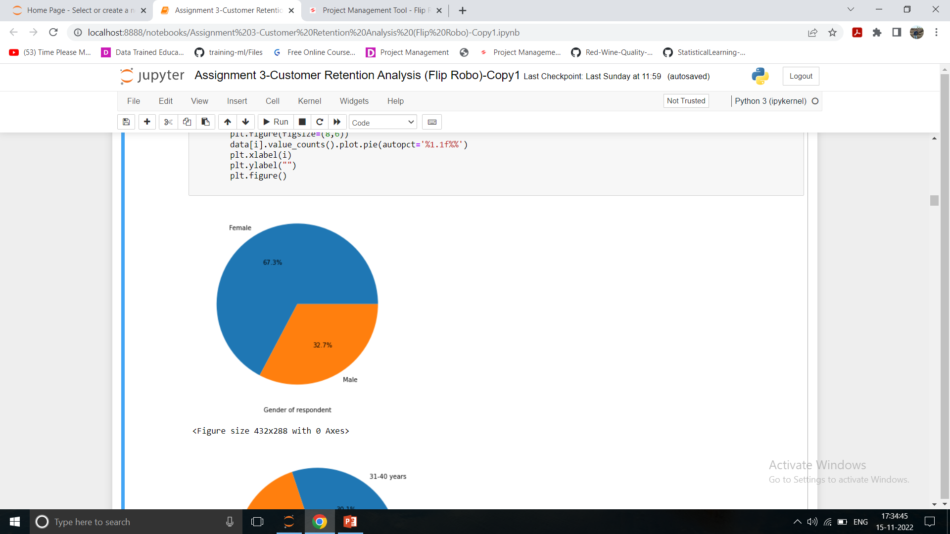
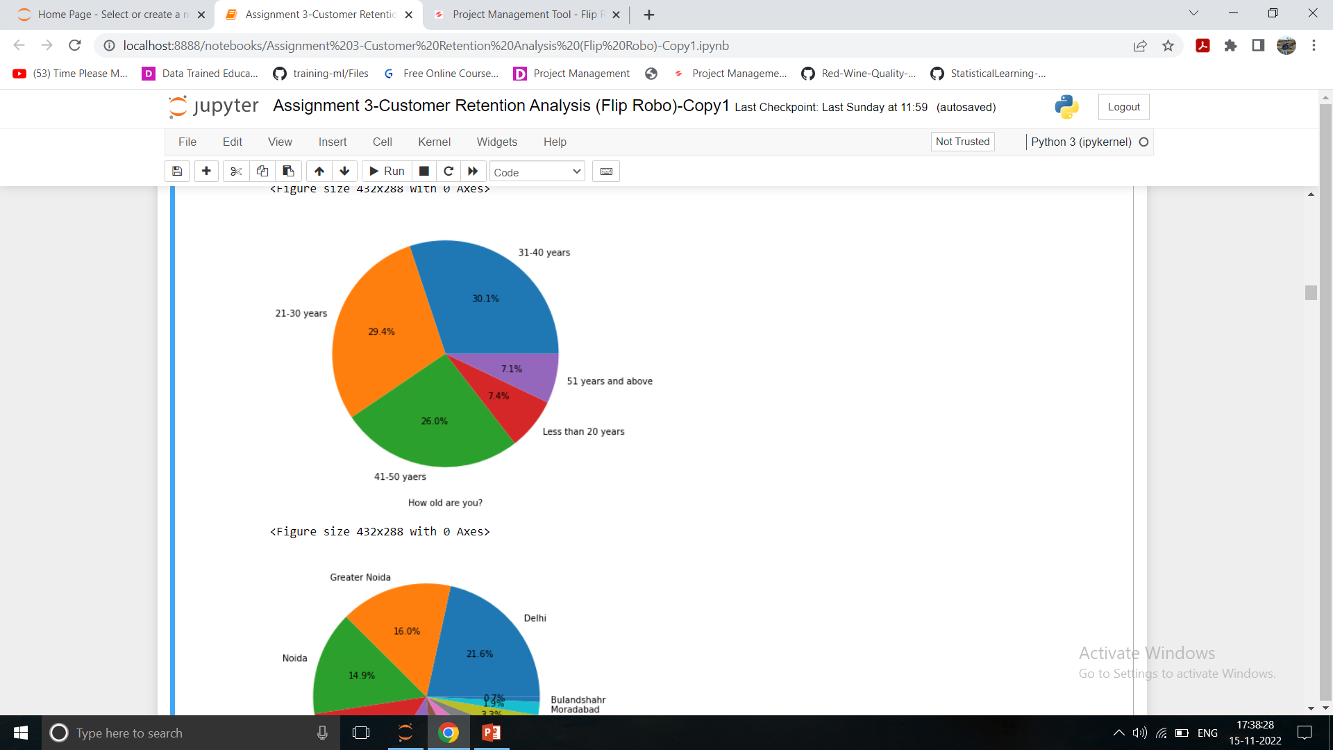
Customer Details:
Gender of Respondent: From below data Female customers are more:67% as compared to male customers:-32%
Age wise customers:-From below chart it is observed there is more no. of custoers are from age group 31-40 years followed by age group 21-30 & 41-50 years. Very less no. of customers are from 20 years & less & 51 years & above.

Slide 6
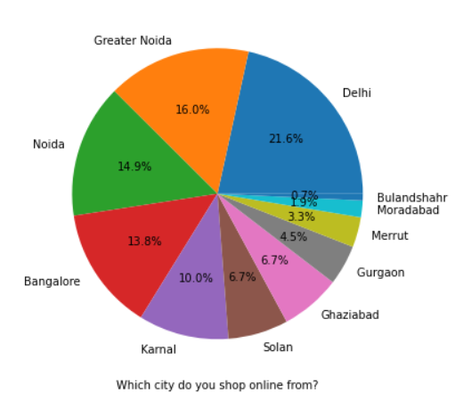
Finding the location wise customers
It is observed that highest no. of customers are from Delhi region: 21%, Followed by Greater Noida: 16% & Noida:14%, Bangalore:13%.
Very less customers are from Bulandshahr, Moradabad, Merut & Gurgaon. It is observed that there is very less awareness about E retail store or people are reliable on local market than E stores.

Slide 7
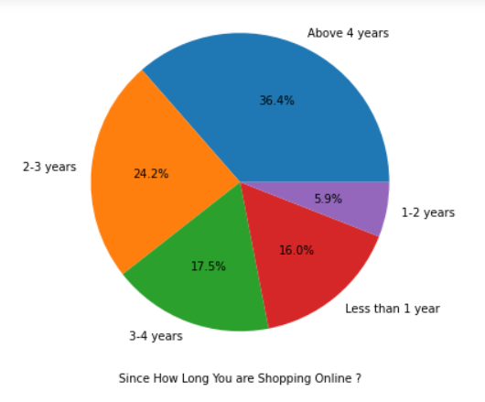
Regular Customers
From 4 years & above majority no. of customers (Around 36%)are buying products from E retails.
from 2-3 years :24% peoples are buying products online.
From 3-4 years :17% peoples are buying products from E retail.
People who are purchasing less than one year is only 16%.
Peoples purchasing from 1-2 years are only :5.9%

Slide 8
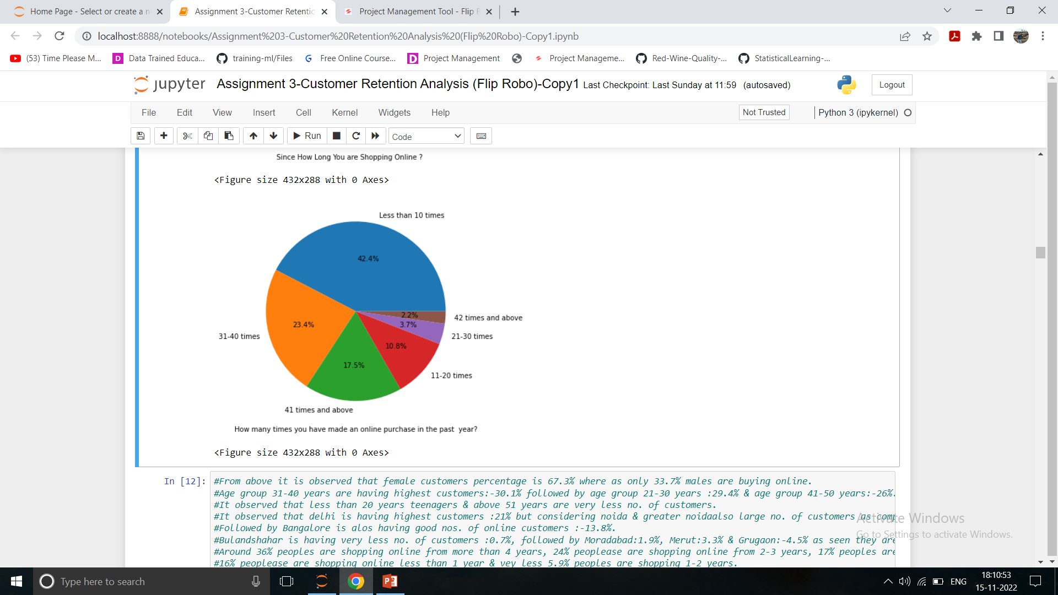
Repeat Customers in past one year
Less than 10 times majority of peoples are shopped from E retail store.(Around :42%)
23% peoples shopped 31-40 times from E retail.
17% peoples are shopped 41 times & above.
10% peoples are shopped 11 -20 times online.
3.7% peoples are shopped 21-30 times.
Very less people who shopped online 42 times & above(Around :2.2%)
It is observed that people who shopped less than 10 times in year are having highest.

Slide 9
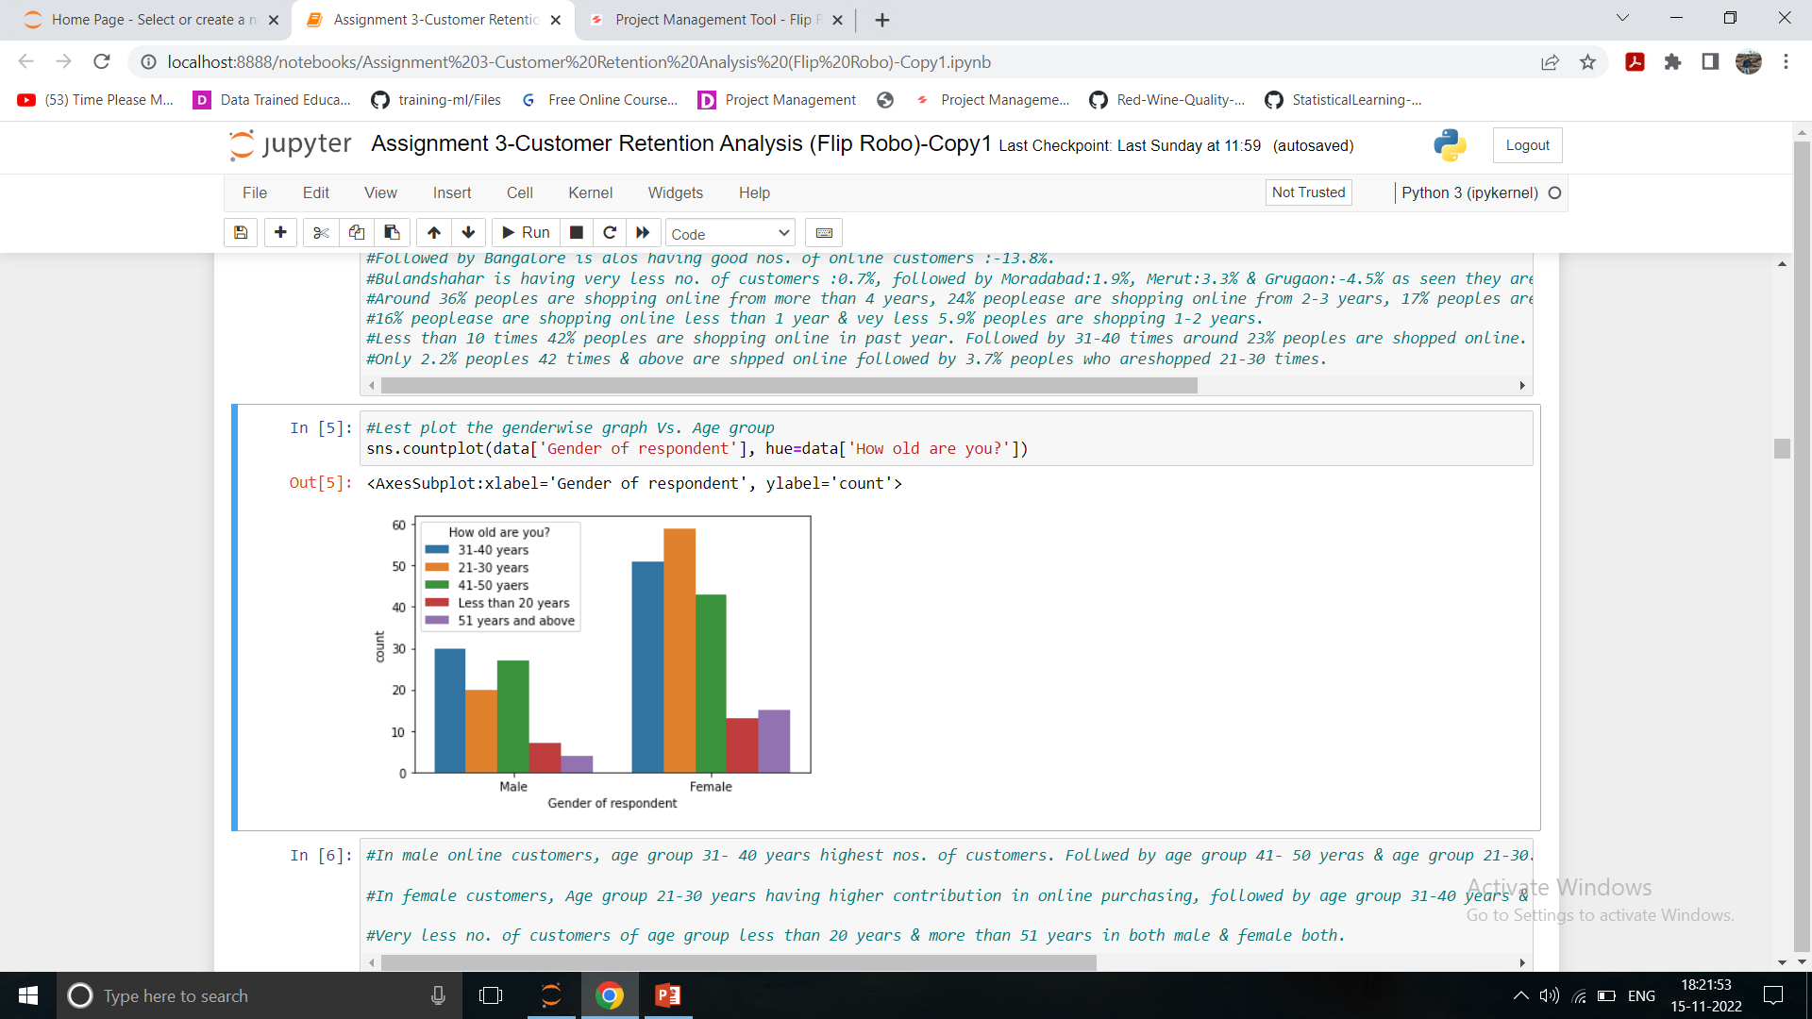
Plotting the graph of Gender Vs Age group
Female customers are from age group 21-30 years are highest customers, followed by age group 31-40 nos. & after that 41-50 years.
Very less female customers are from teenager group less than 20 years & above 50 years.
As compared to female less male E retails customers.
In male customers, the age group 31-40 years are highest, followed by age group 41-50 years.
Same as female group very less customers from teen agers & above 51 years.

Slide 10
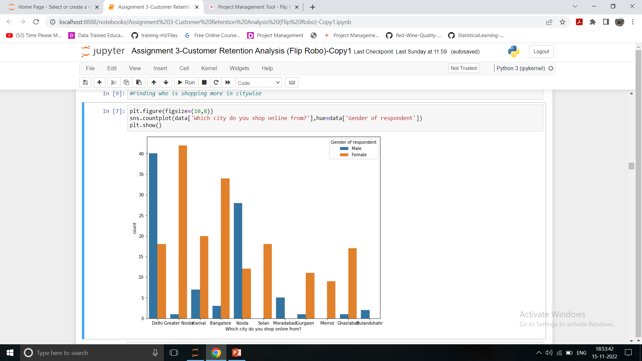
Location wise customers
As per above data overall female customers are higher than male but looking at the Delhi & Noida the male customers are higher than female customers.

Slide 11
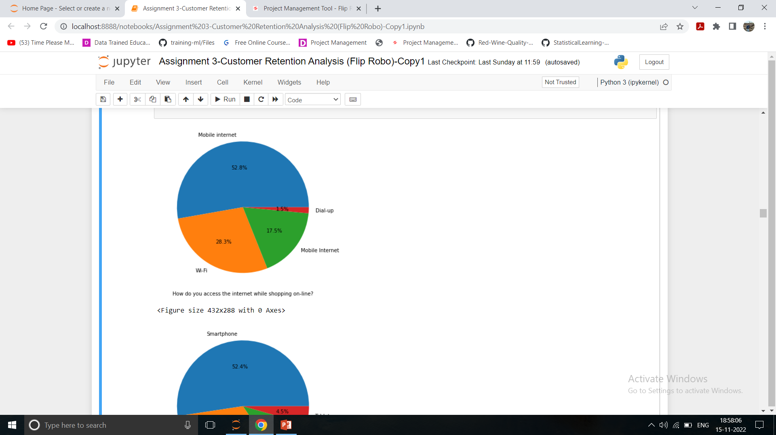

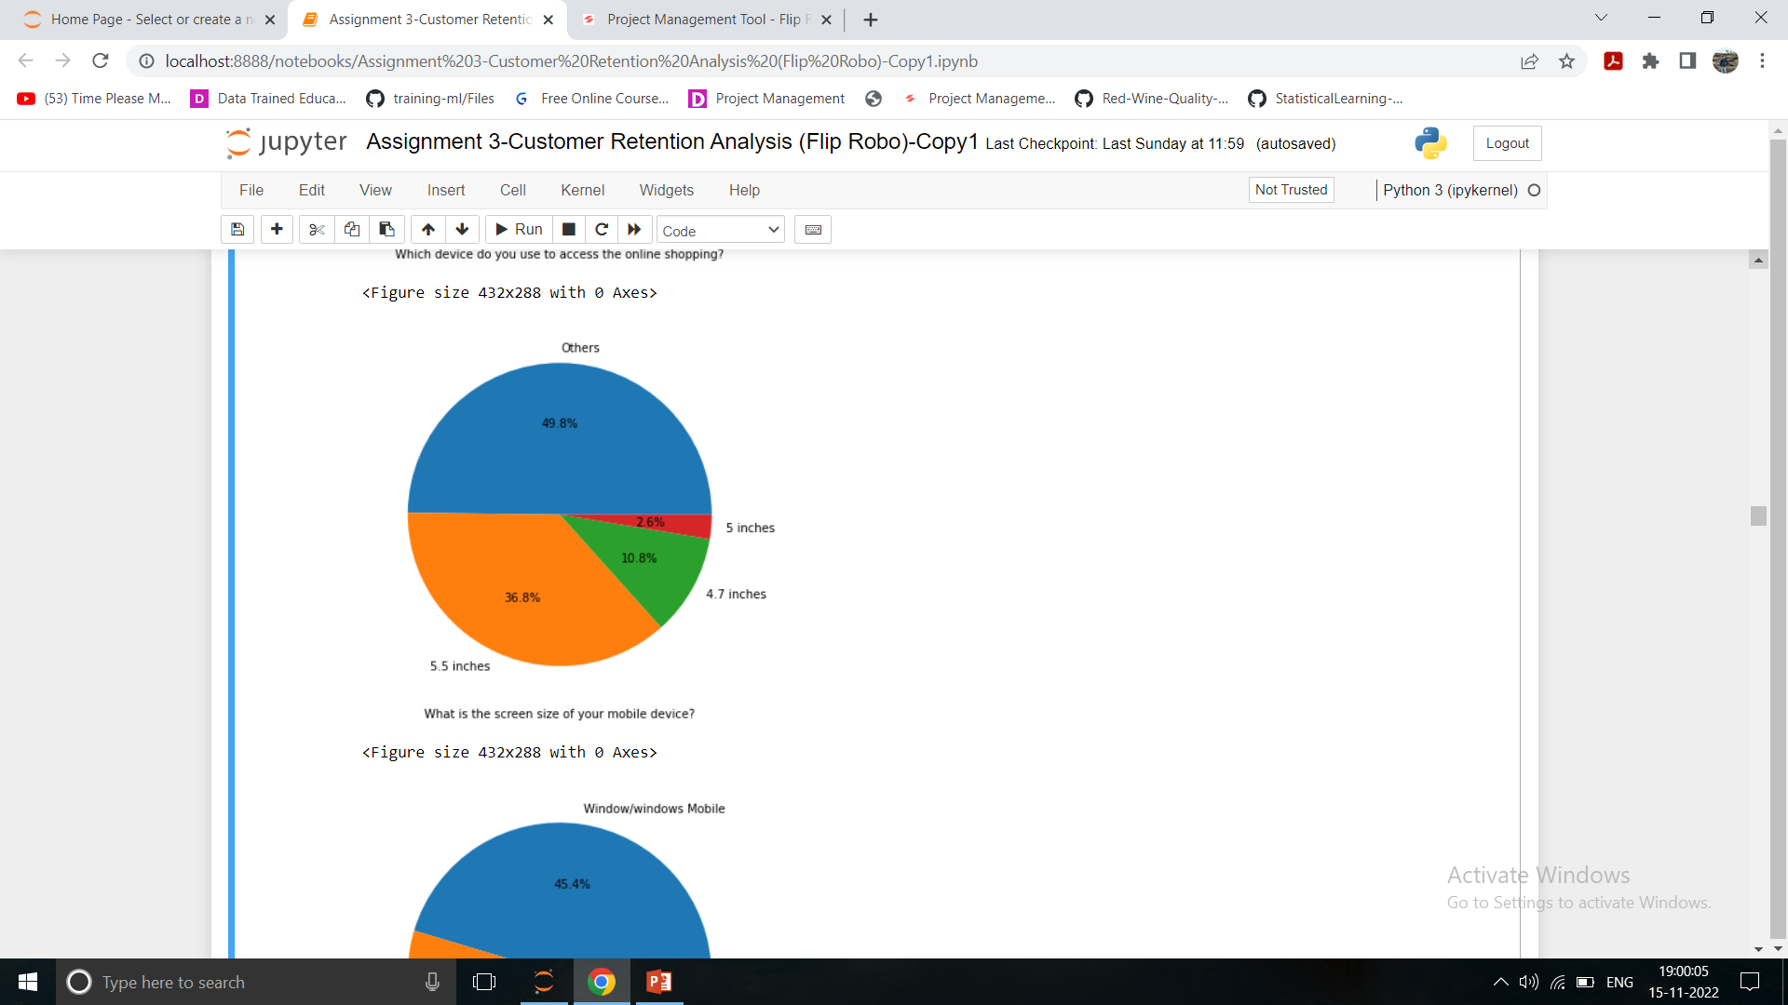
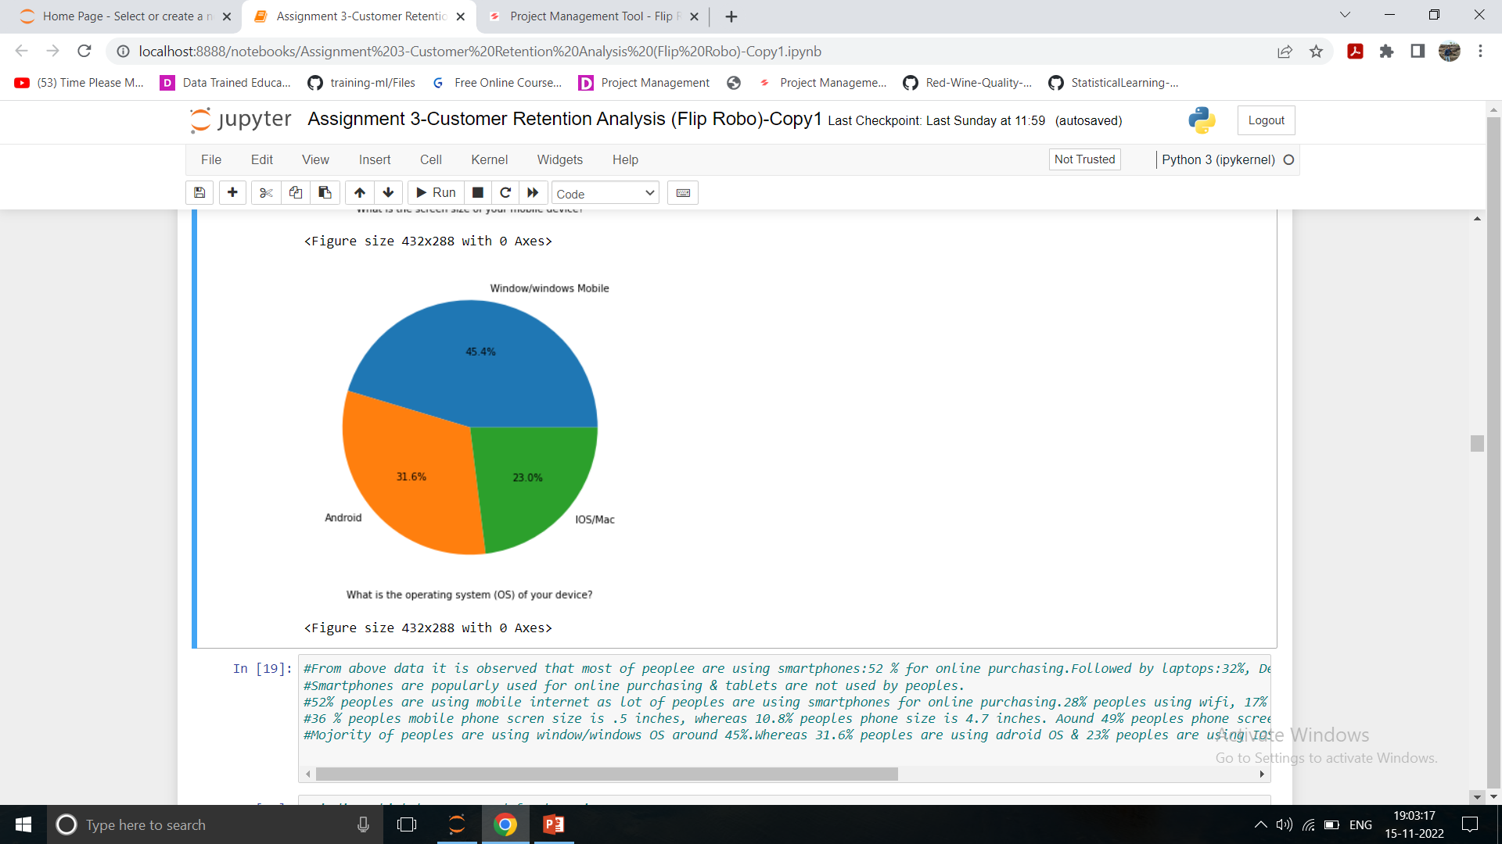
Device Details
Peoples are generally used mobile internet around 52% for accessing internet, followed by WiFi:28%, Mobile internet:17% & Dial Up 1.5% only.
Smartphones are generally used for online shopping (Around 52%) , followed by laptop:32% , only 11% peoples are using desktops, Very less peoples are using tablets :4.5% only.
Peoples generally using 5.5 inches screen :36%, followed by 49% peoples are using other screen mobiles which screen size is not mentioned, 10% peoples are using 4.7inches screen & very less nos. of peoples are using 5 inches screen.
45% peoples are using Windows/windows mobile operating system may be due to used in laptops, desktop, & some windows mobiles, followed by 31% peoples using Android OS, & only 23% peoples are using IOS/Mac OS.

Slide 12
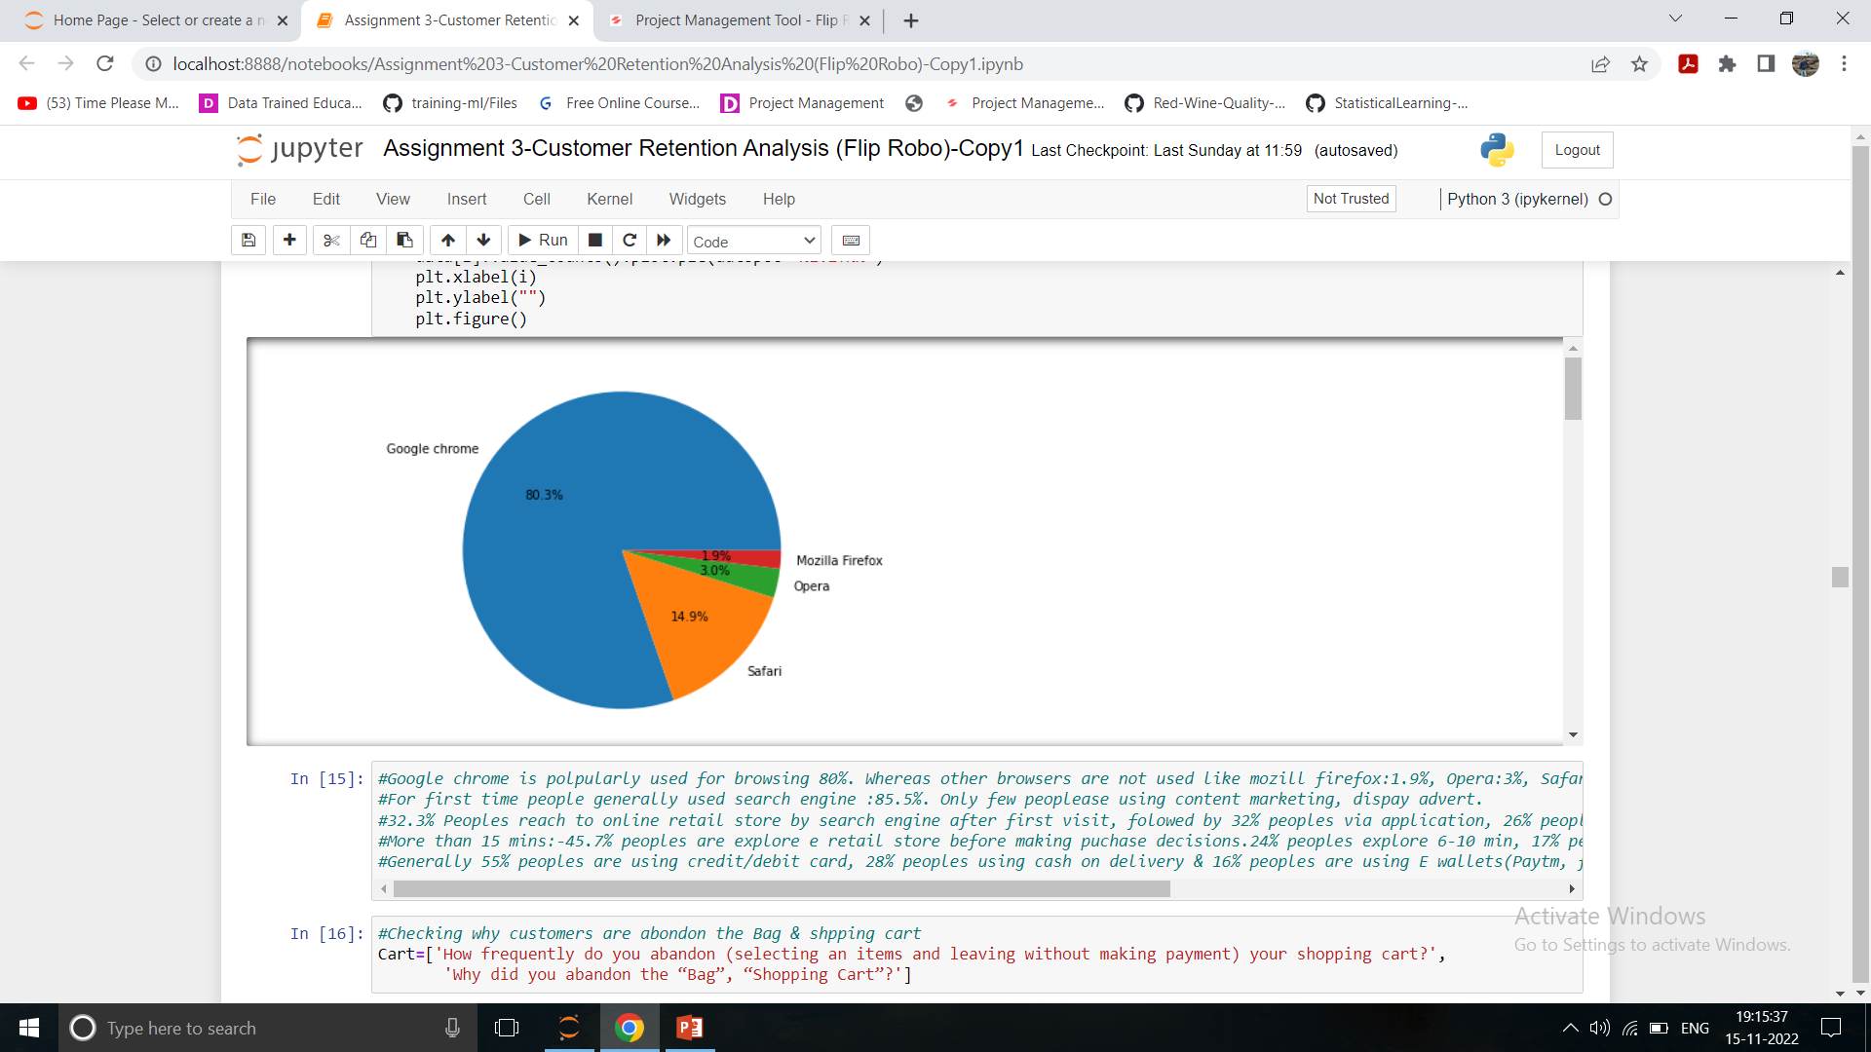
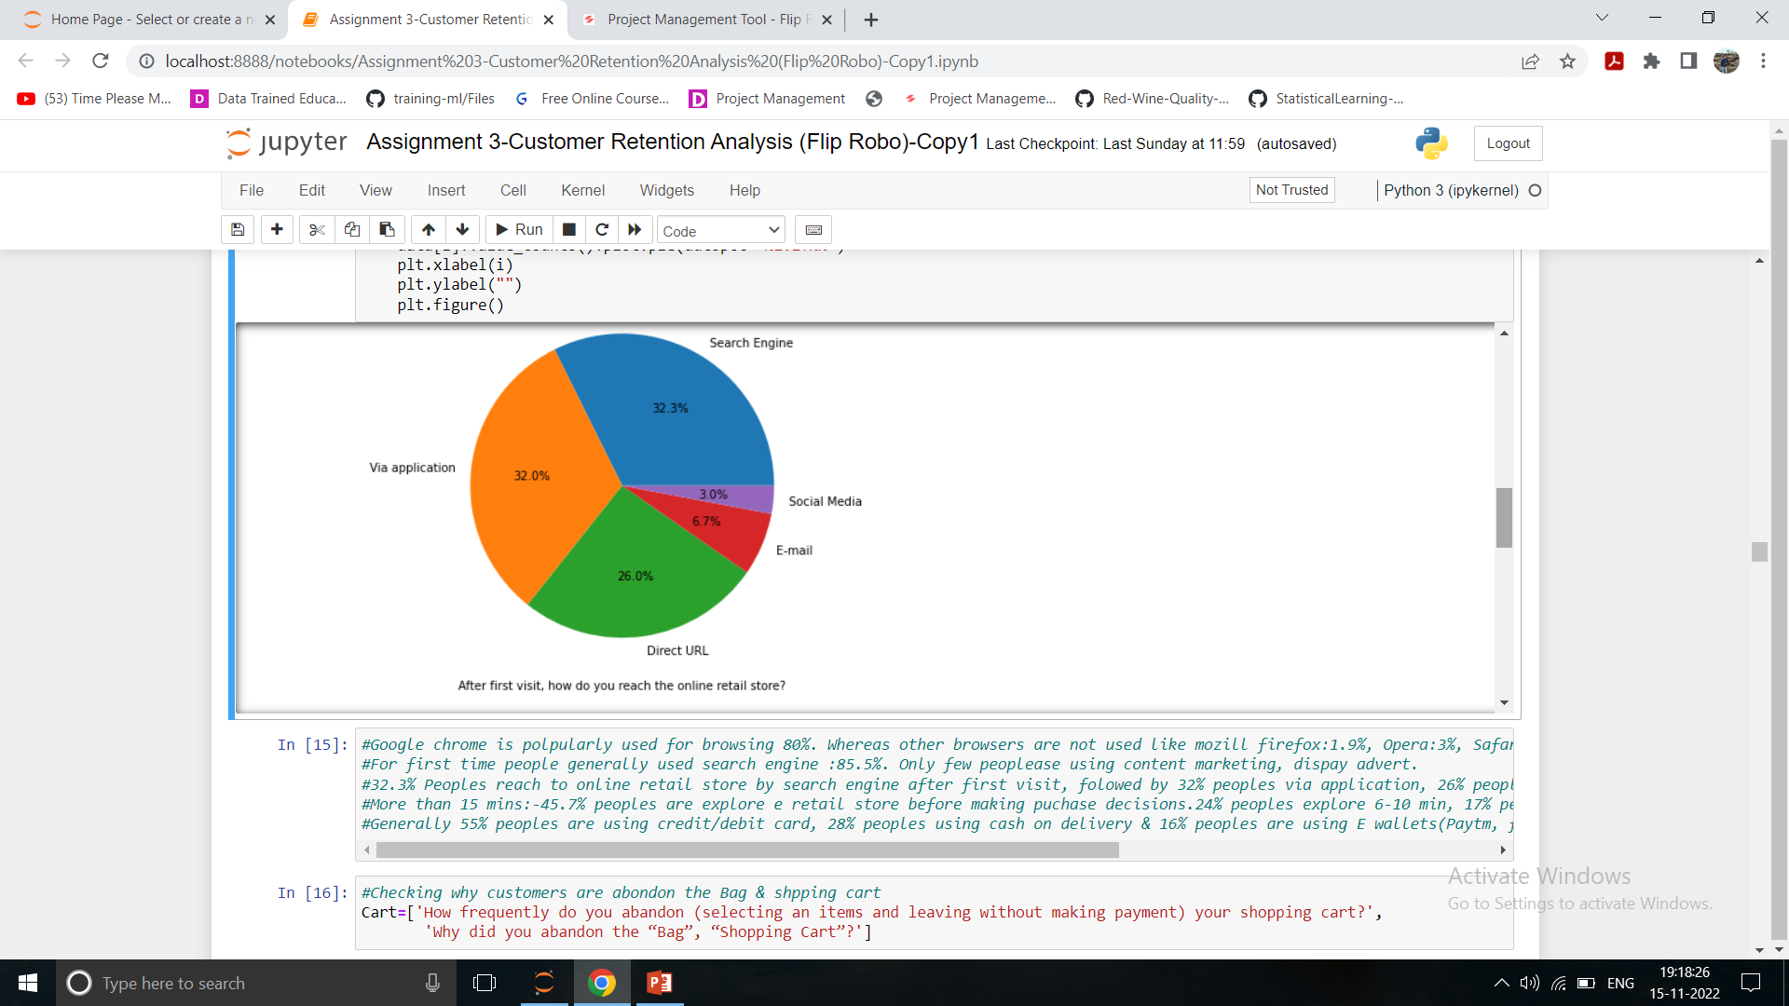
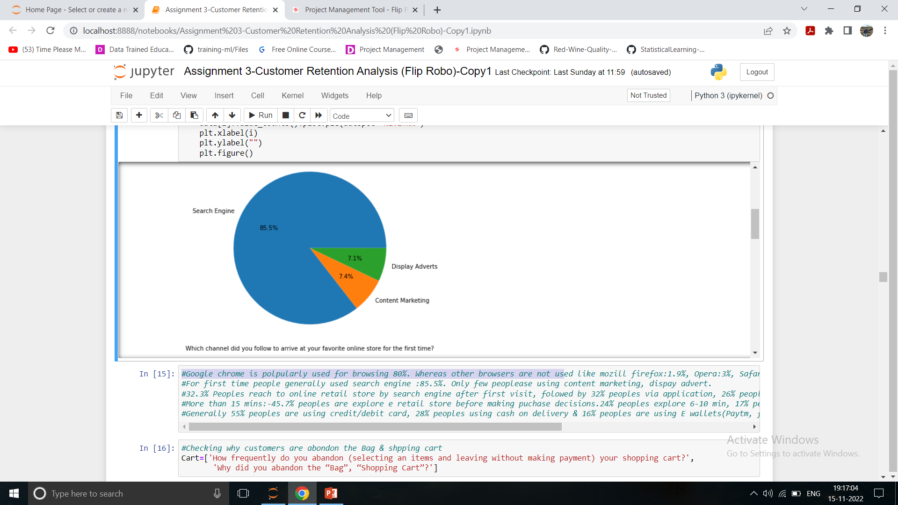
Browser Details
Peoples are generally using Google Chrome:80% to reached at E retail store, followed by 14% peoples are using Safari, 3% peoples are using Opera, 1.9% peoples are using Mozilla Firefox.
After first time visit, 32 % peoples re reaching via application & Search engine, 26% peoples are reaching by Direct URL, 6% by E Mail, 3% by Social media.
For first time people mostly preferred search engine :85% to reach at favourite online store, followed by 7.4% people reached by content marketing, 7.1% by Display & advertisement.

Slide 13
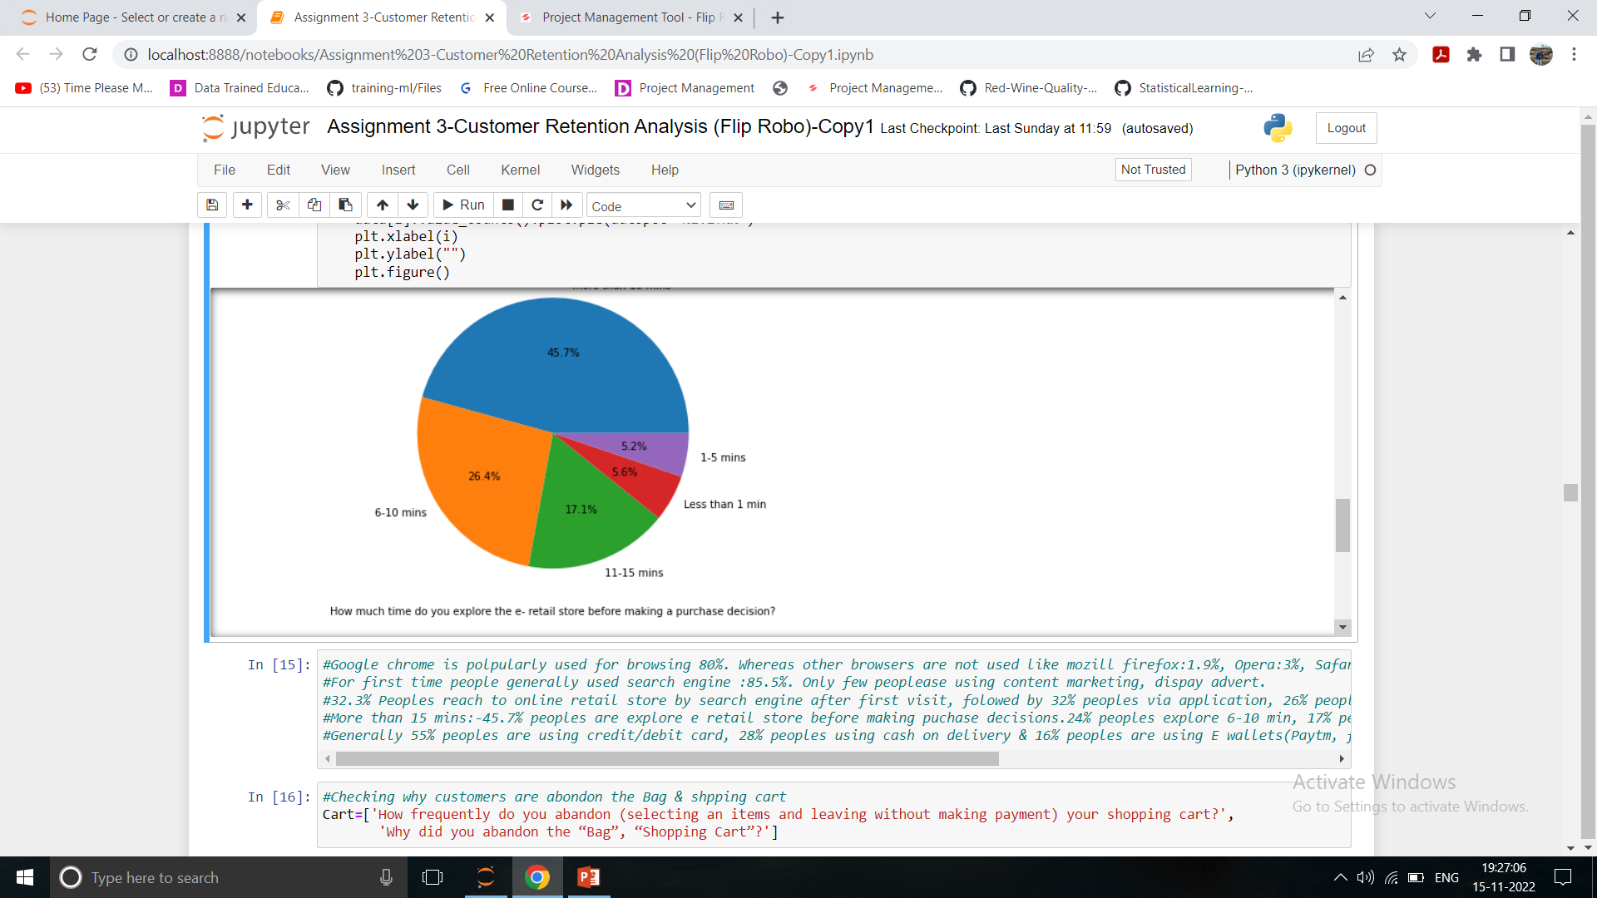
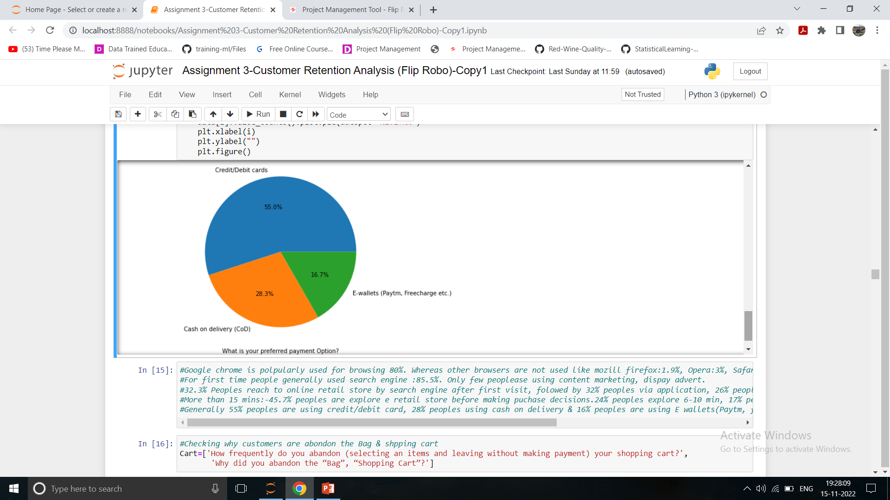
Purchasing Decision & Payment Option
Around 45.7% peoples are exploring e retail more that 15 min before making purchase decision, followed by 26% peoples are exploring 6-10 mins, 17% peoples exploring 11-15 mins. , 5.6% less than 1 mins, 5.2% peoples 1-5 mins.
Generally 55% peoples using Credit/Debit card for online purchasing, followed by 28% peoples using cash on delivery option, 16% peoples using E wallet option.

Slide 14
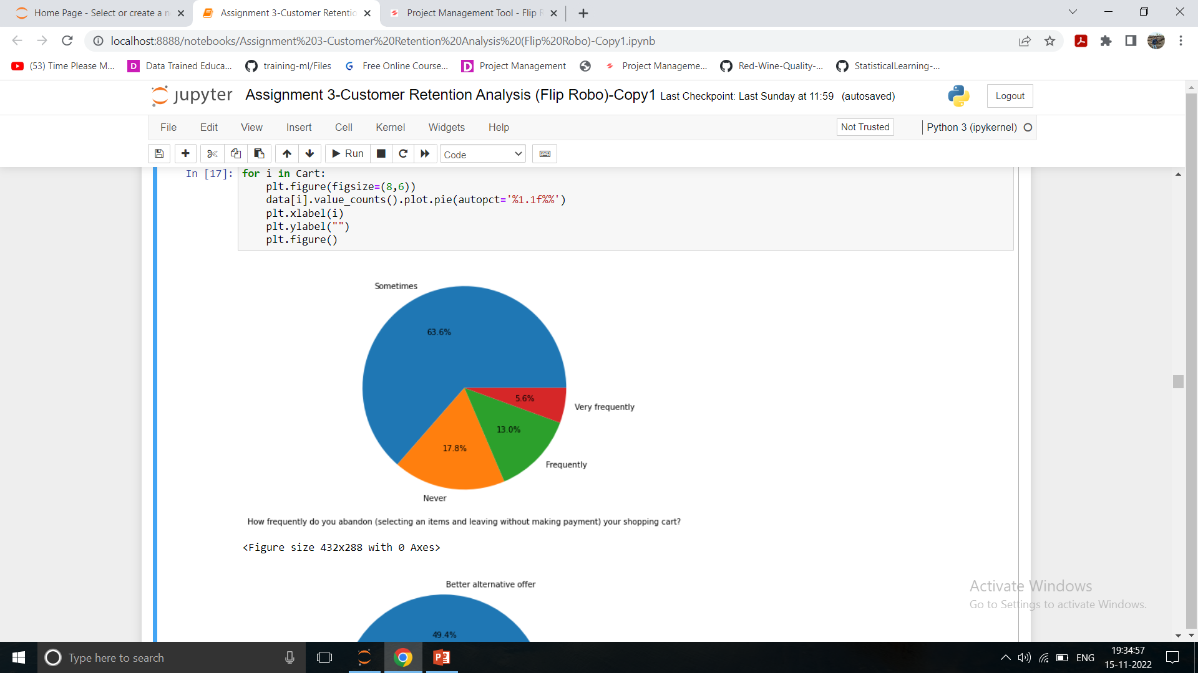
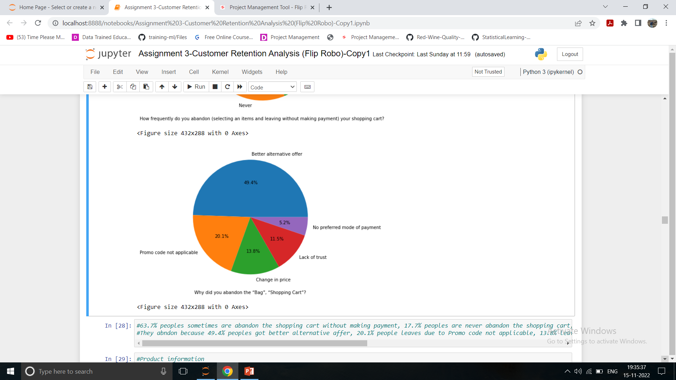
Why Peoples abandon item in Cart?
Around 63% peoples sometimes abandon the item cart without making payment, 17% peoples are never abandon the cart, 13% peoples are frequently abandon the shopping, 5.6% peoples are very frequently.
49% people abandon because of they got better alternative offer, 20% because of Promo code not applicable, 13% due to change in price, 11% due to lack of trust on products, 5% due to no preferred mode of payment.

Slide 15
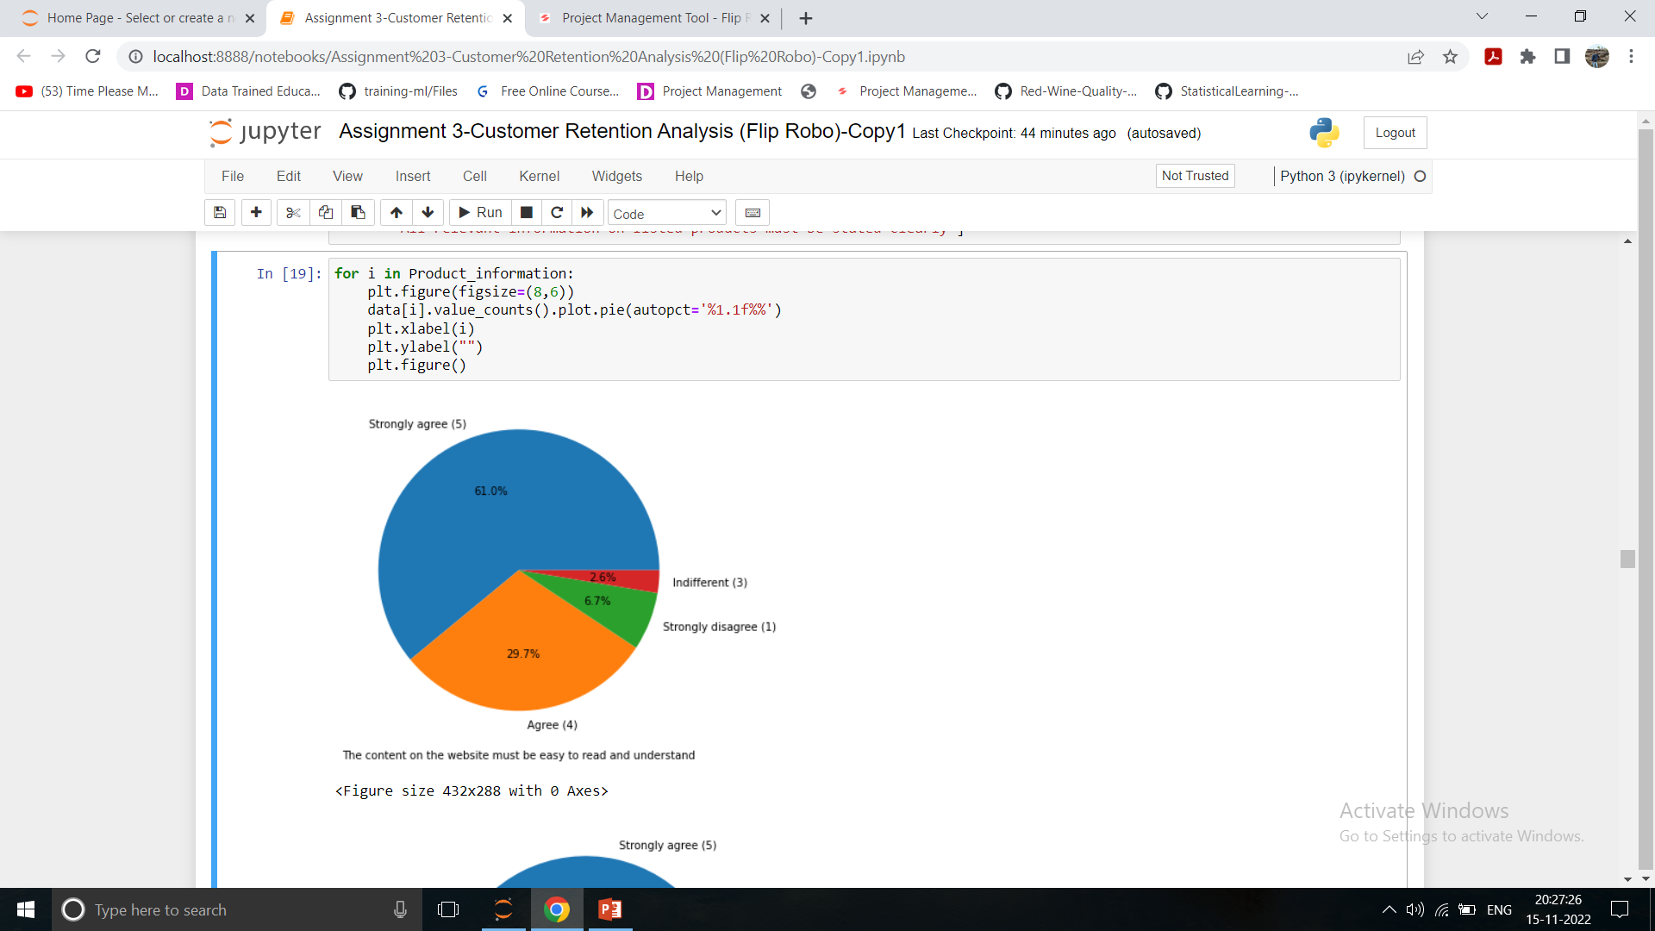
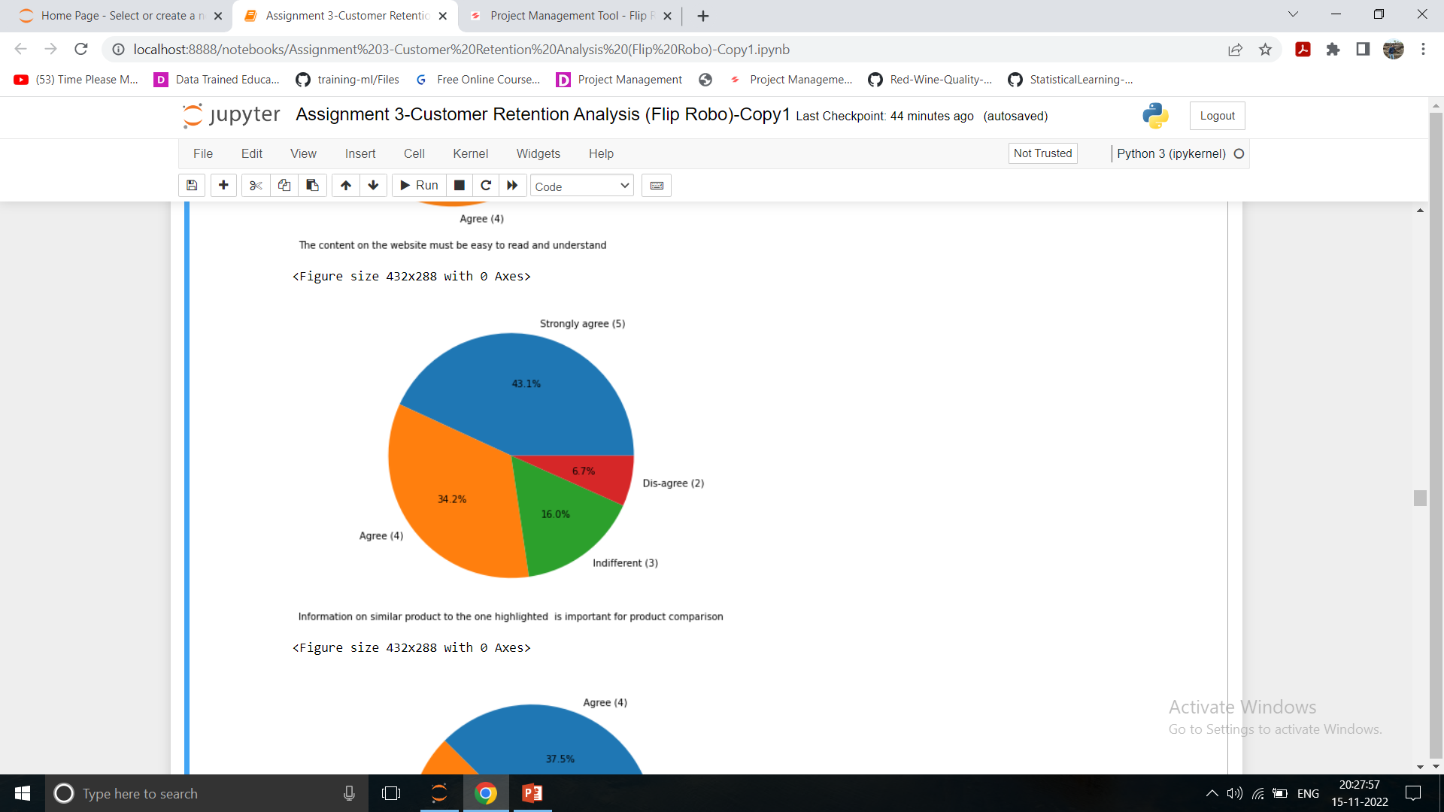
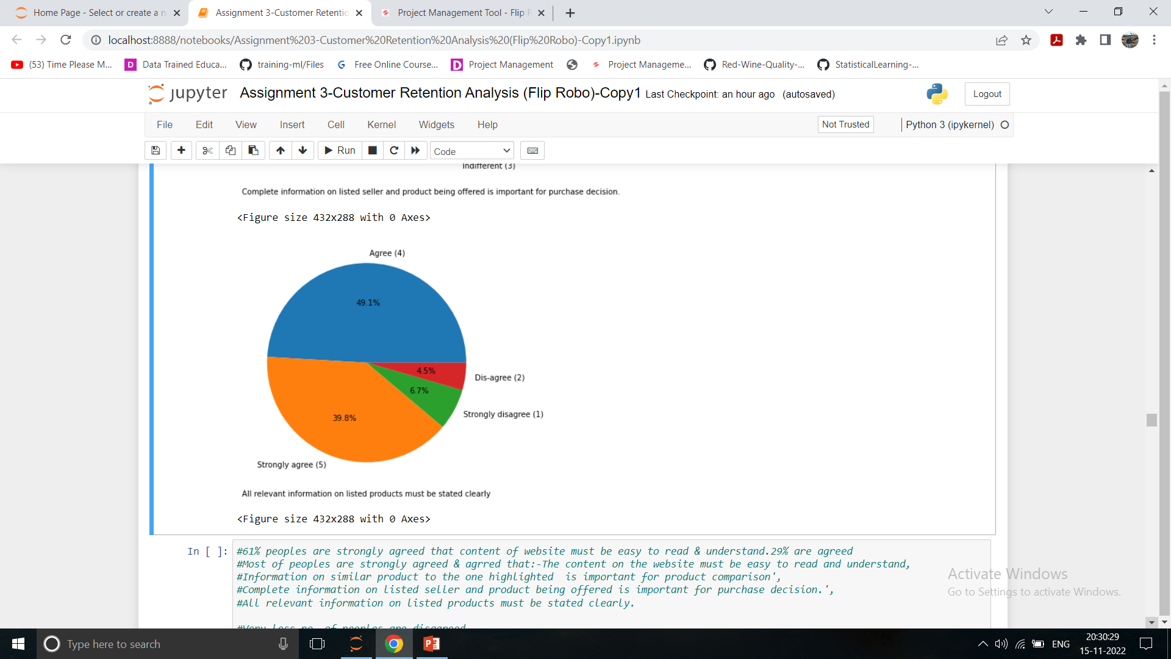
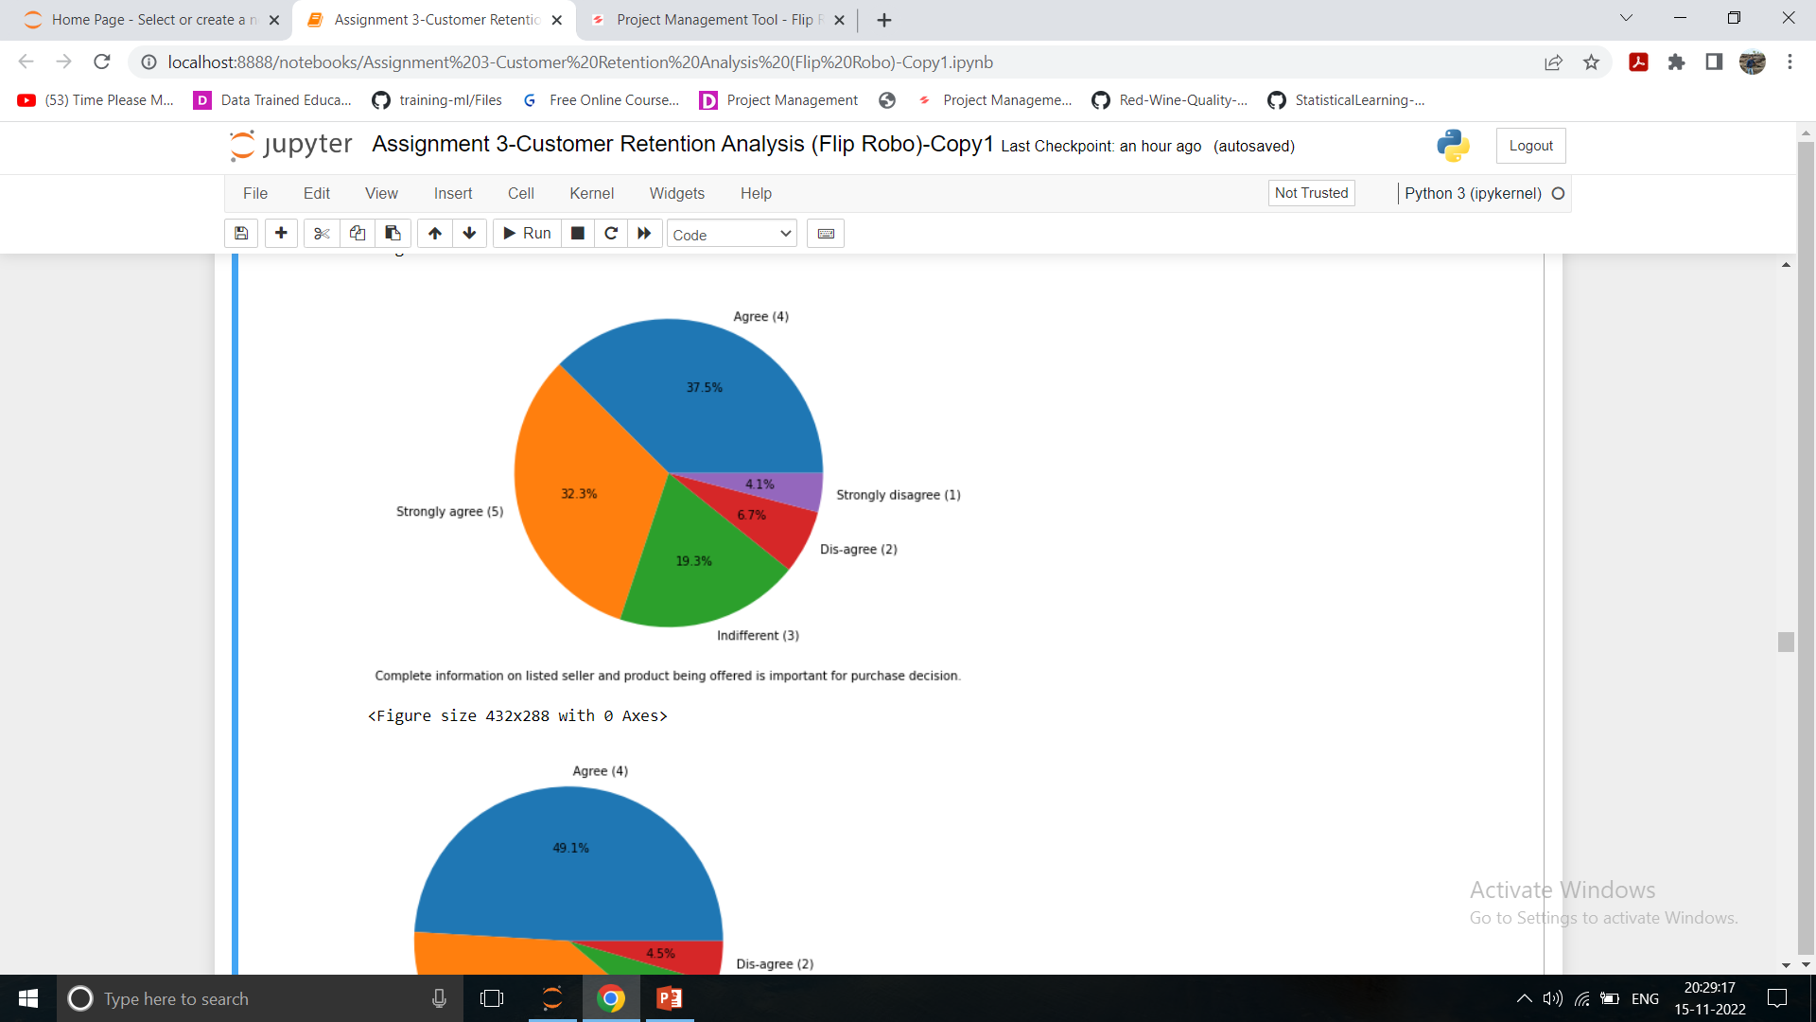
Product Information
Most of peoples are strongly agreed & agreed in favour that the content on the website must be easy to read & understand, information on similar product to the one highlighted is important for product comparison, complete product is important for purchase decision & all relevant information on listed products must be stated clearly.
It is necessary requirement for purchasing any item.

Slide 16
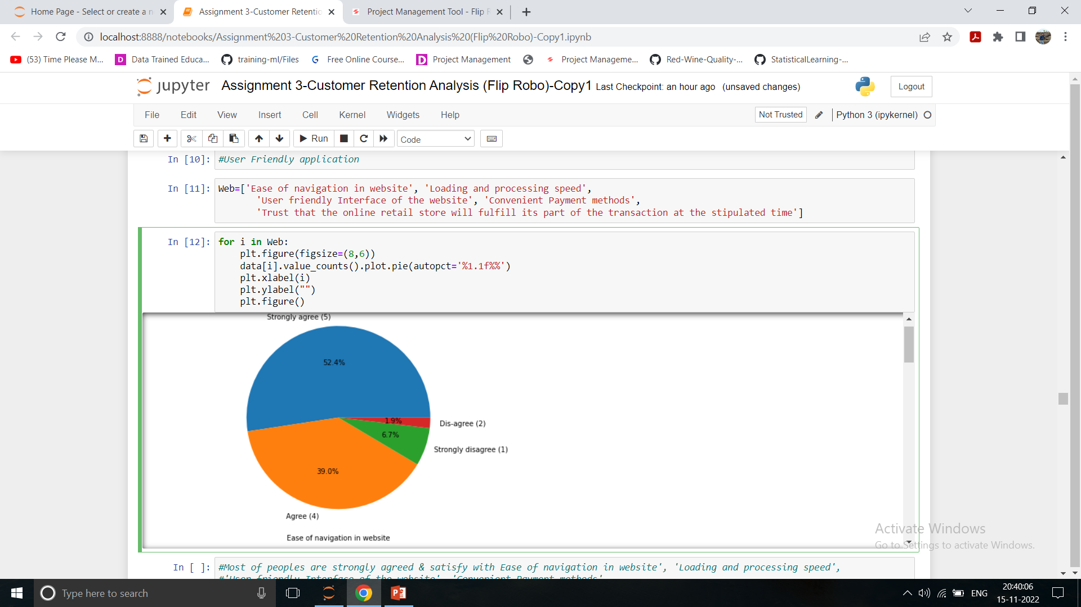
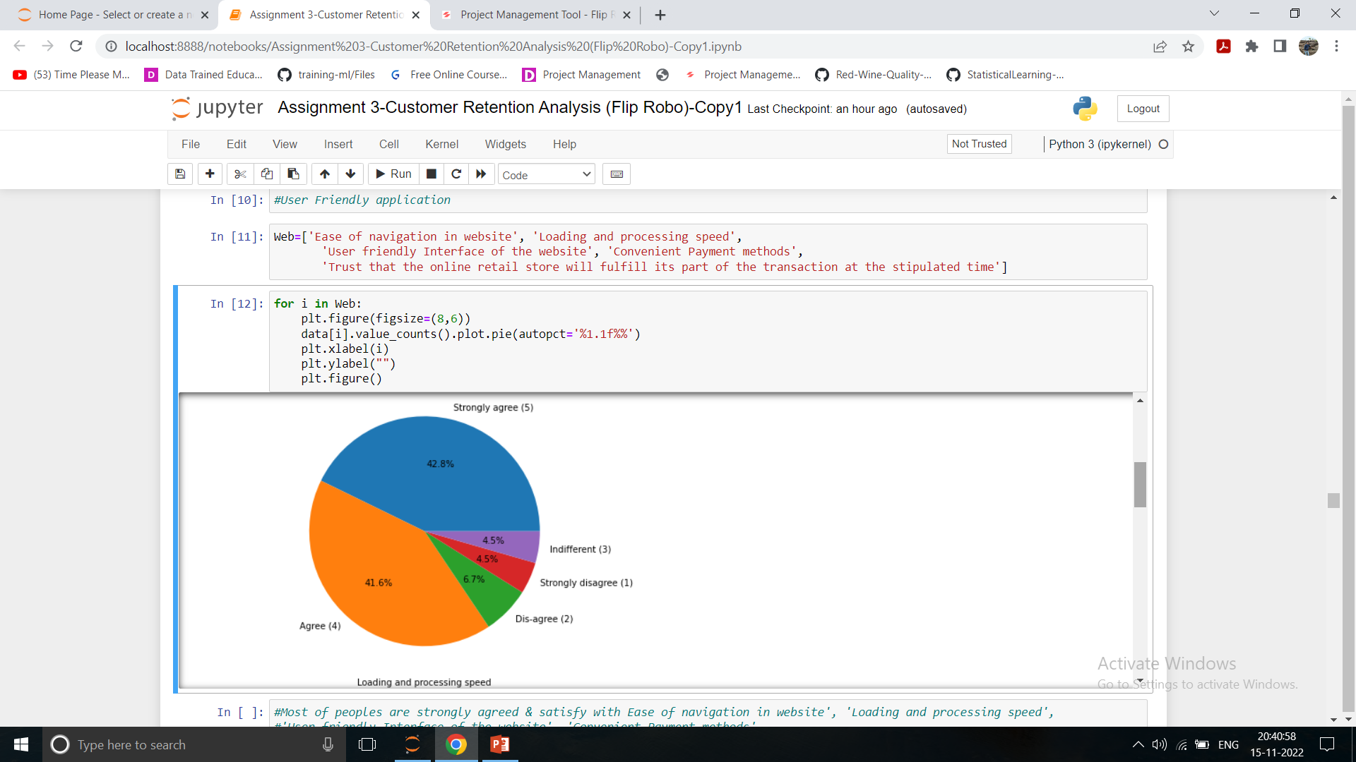
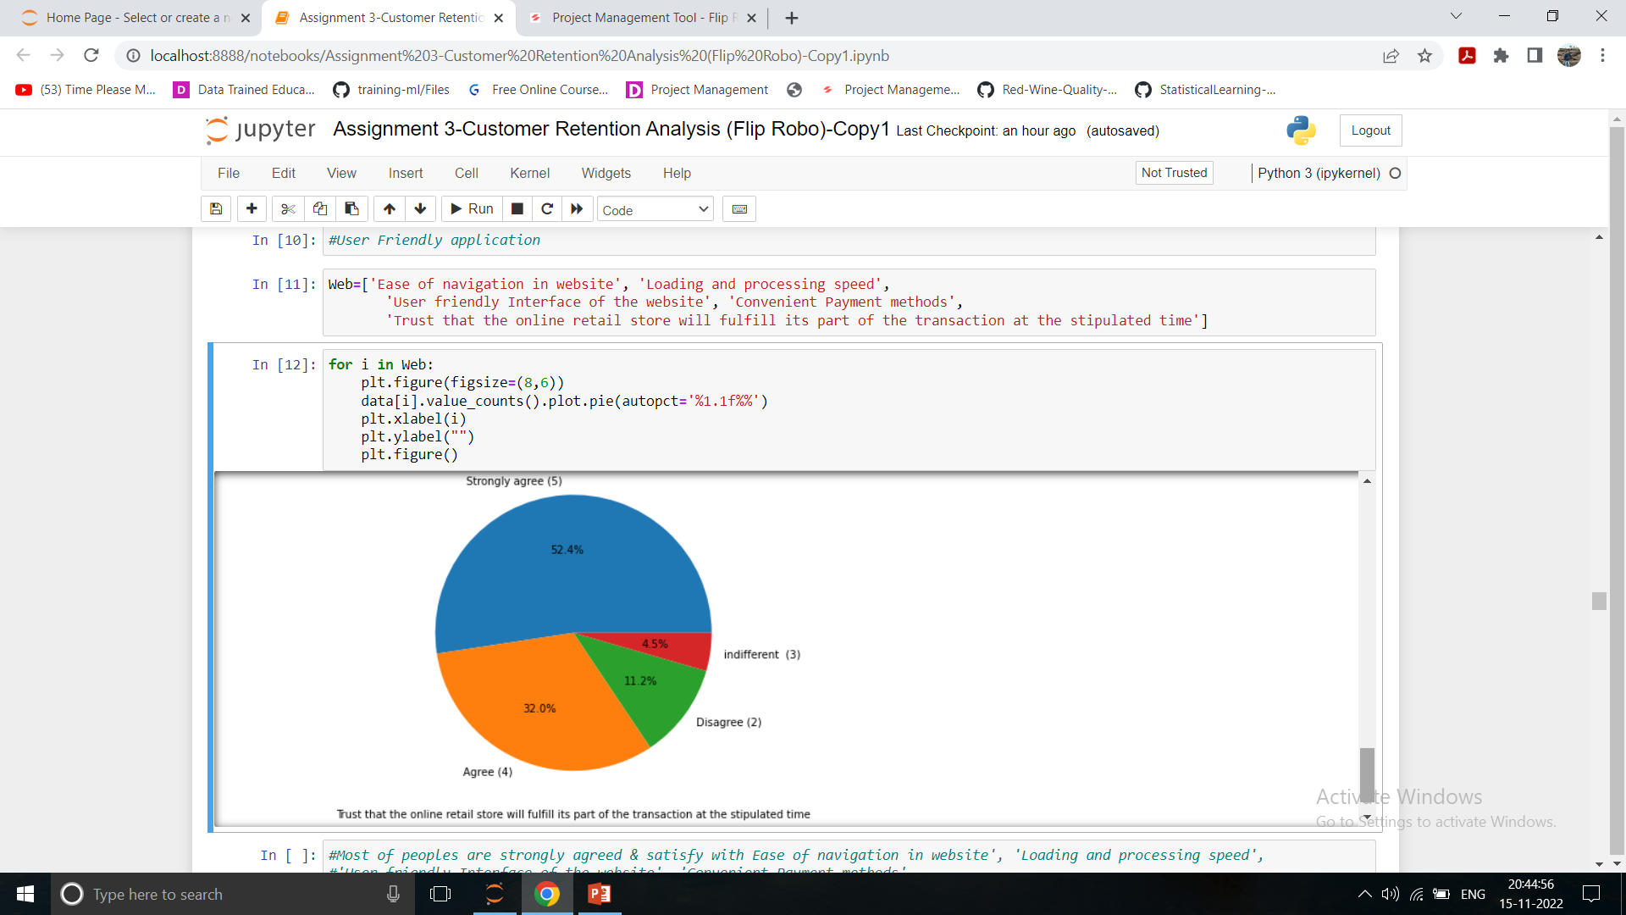
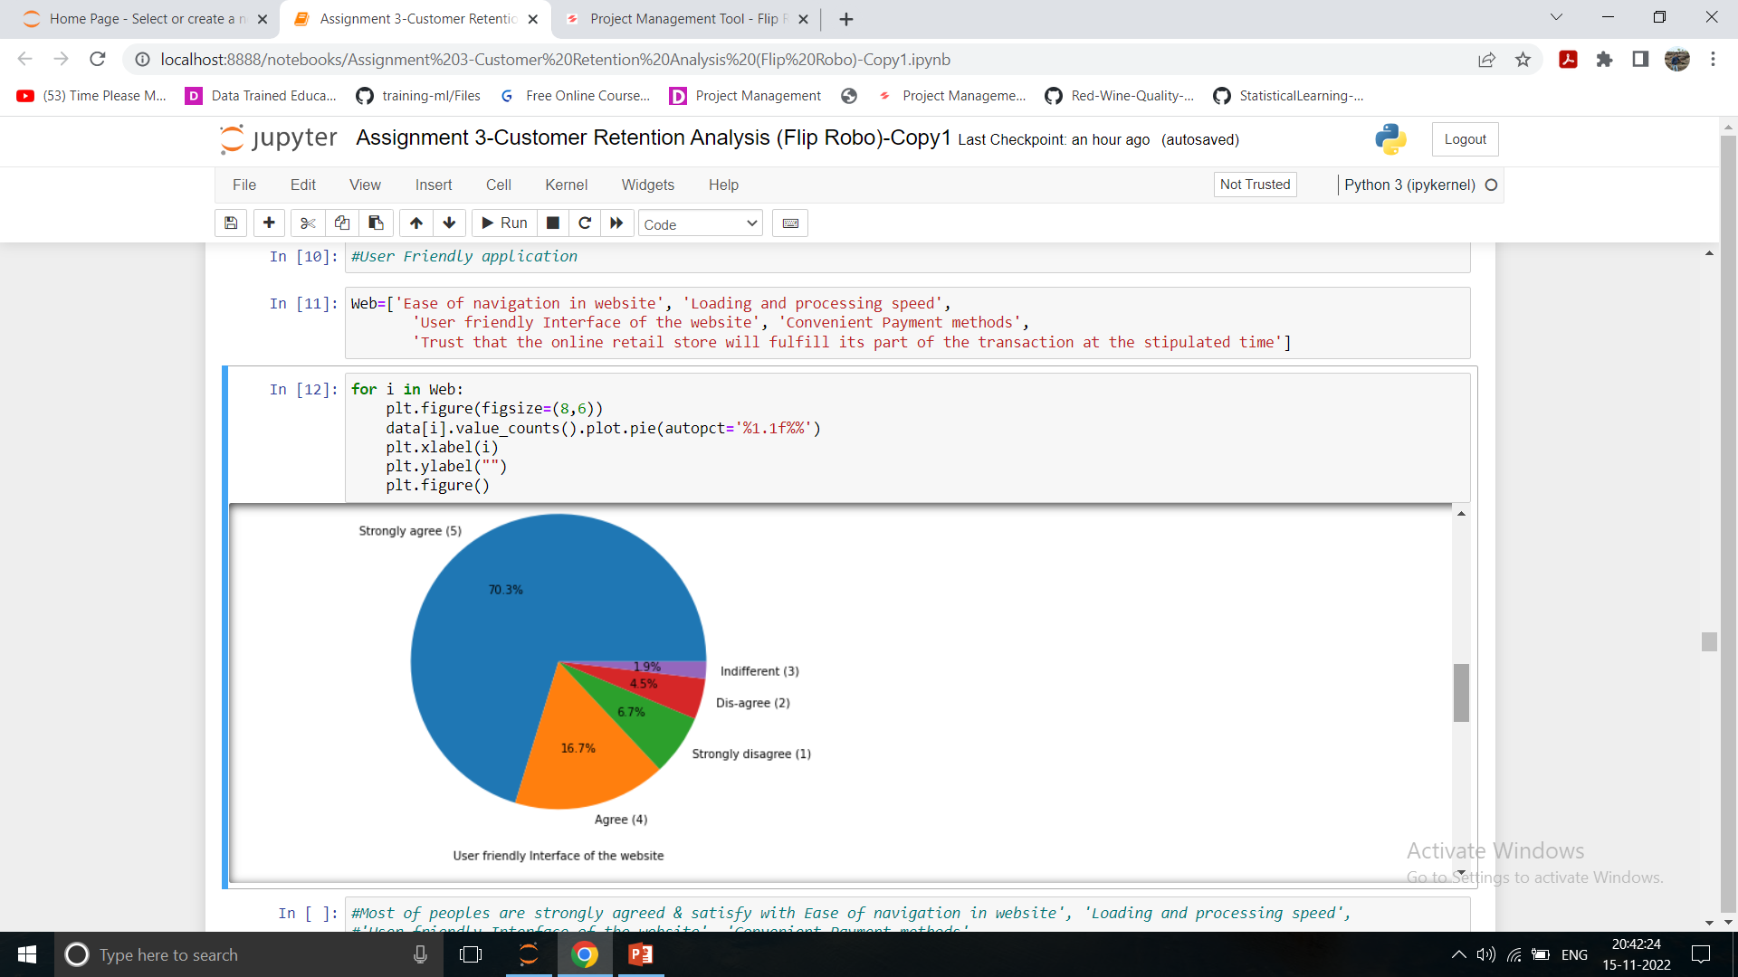
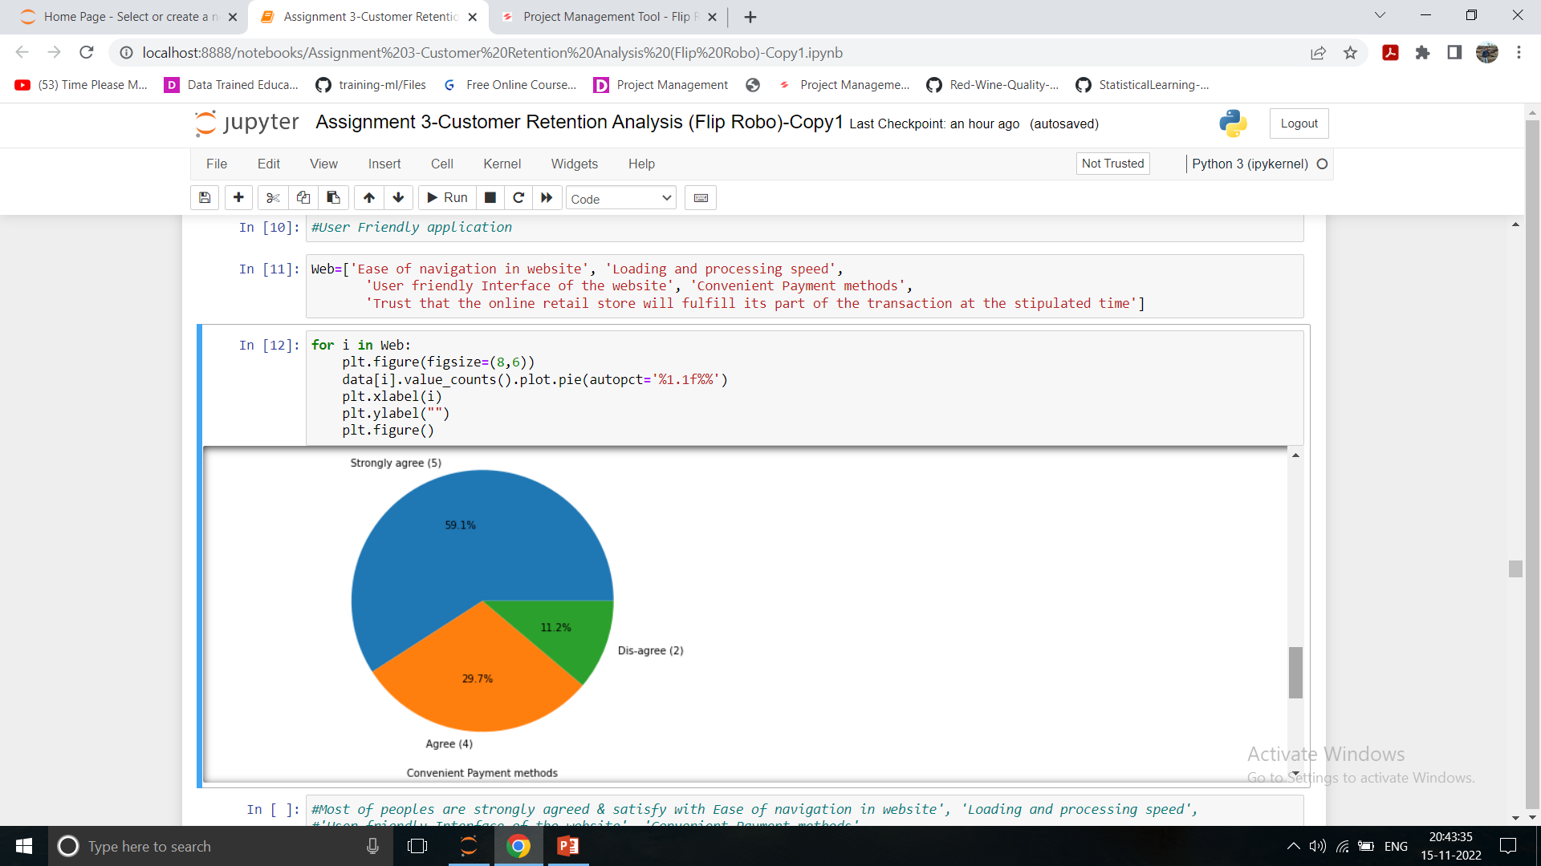
System Quality(Application Quality)
Most of peoples are strongly agreed & agreed that Ease of navigation in website, Loading and processing speed must be good, User friendly Interface of the website, Convenient Payment methods requirement, Trust that the online retail store will fulfill its part of the transaction at the stipulated time.
All this system quality requirements must be fulfill.

Slide 17
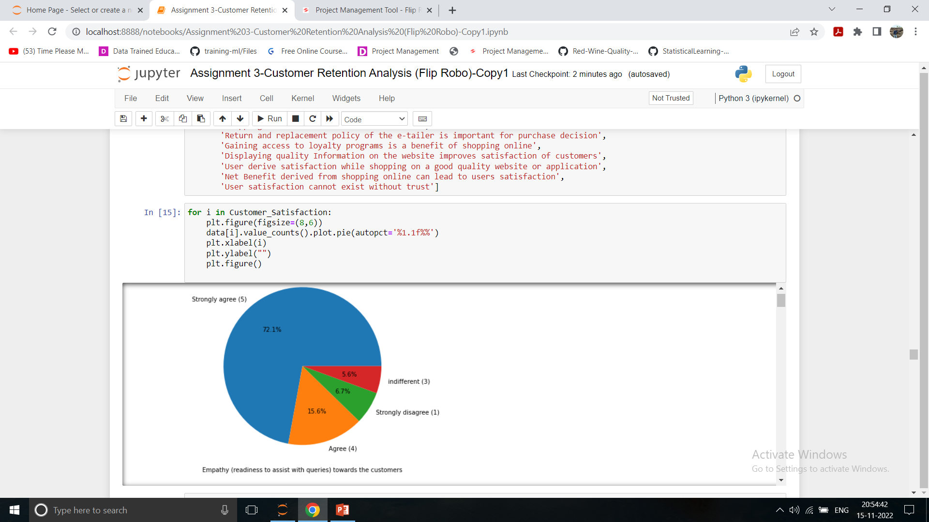
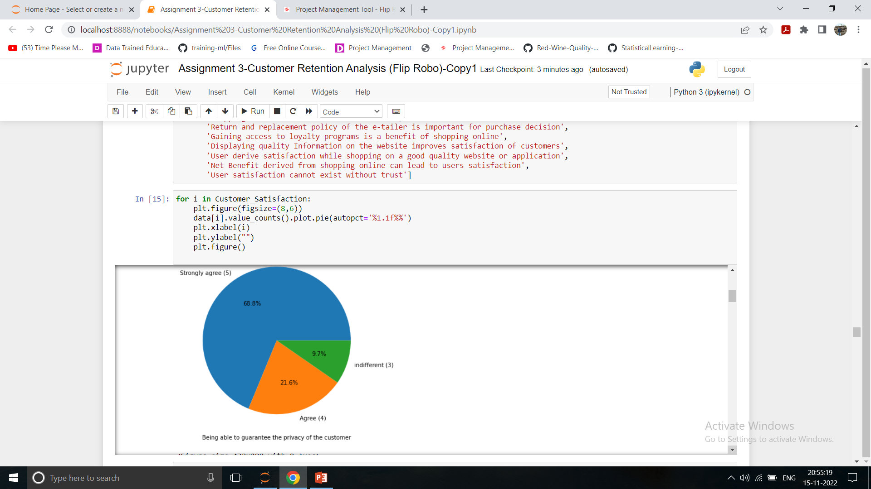
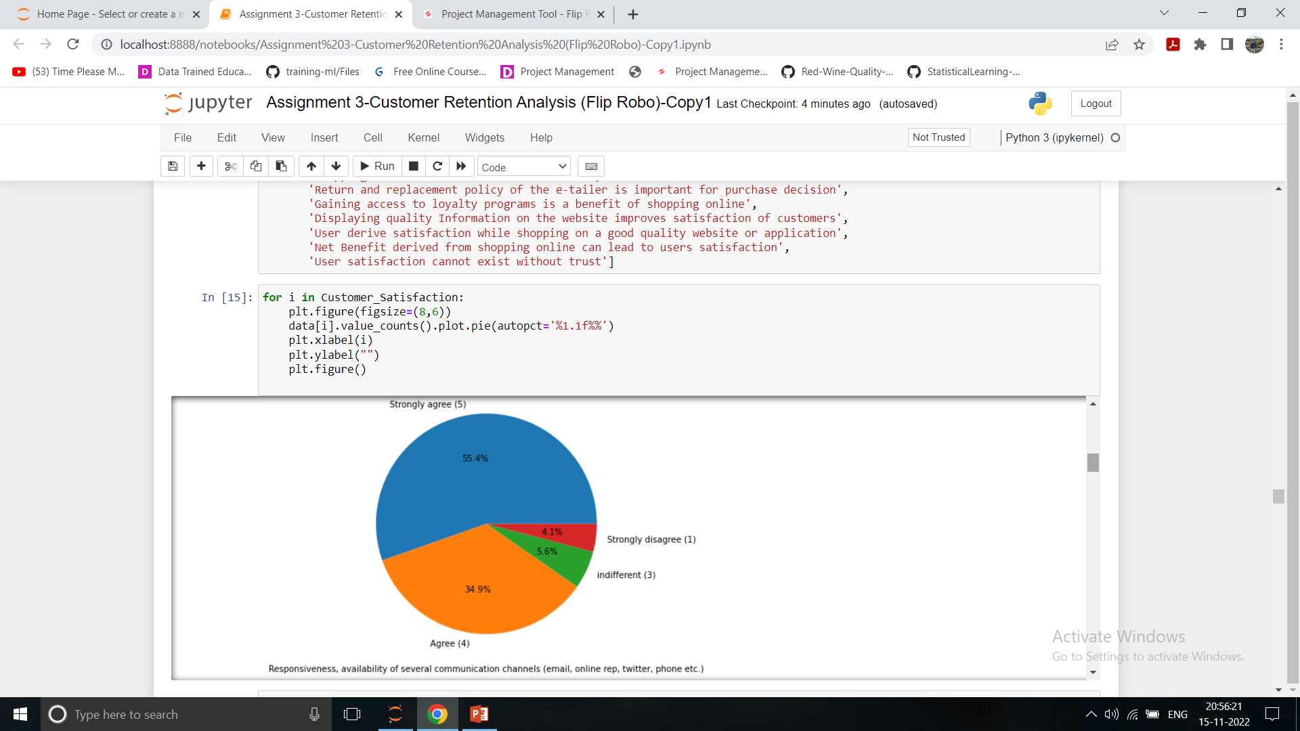
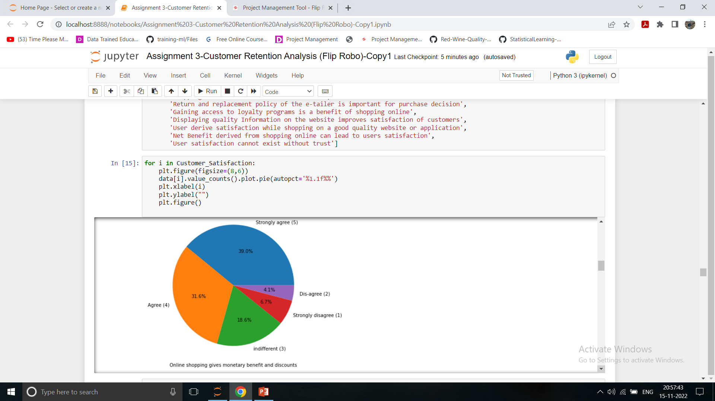
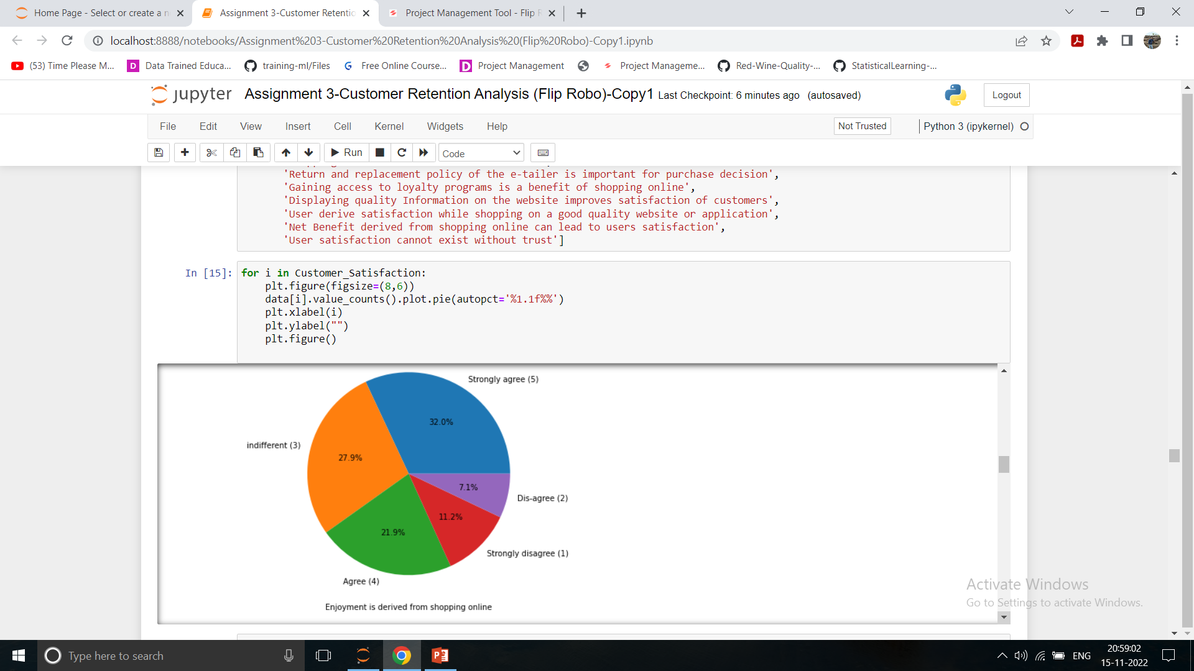
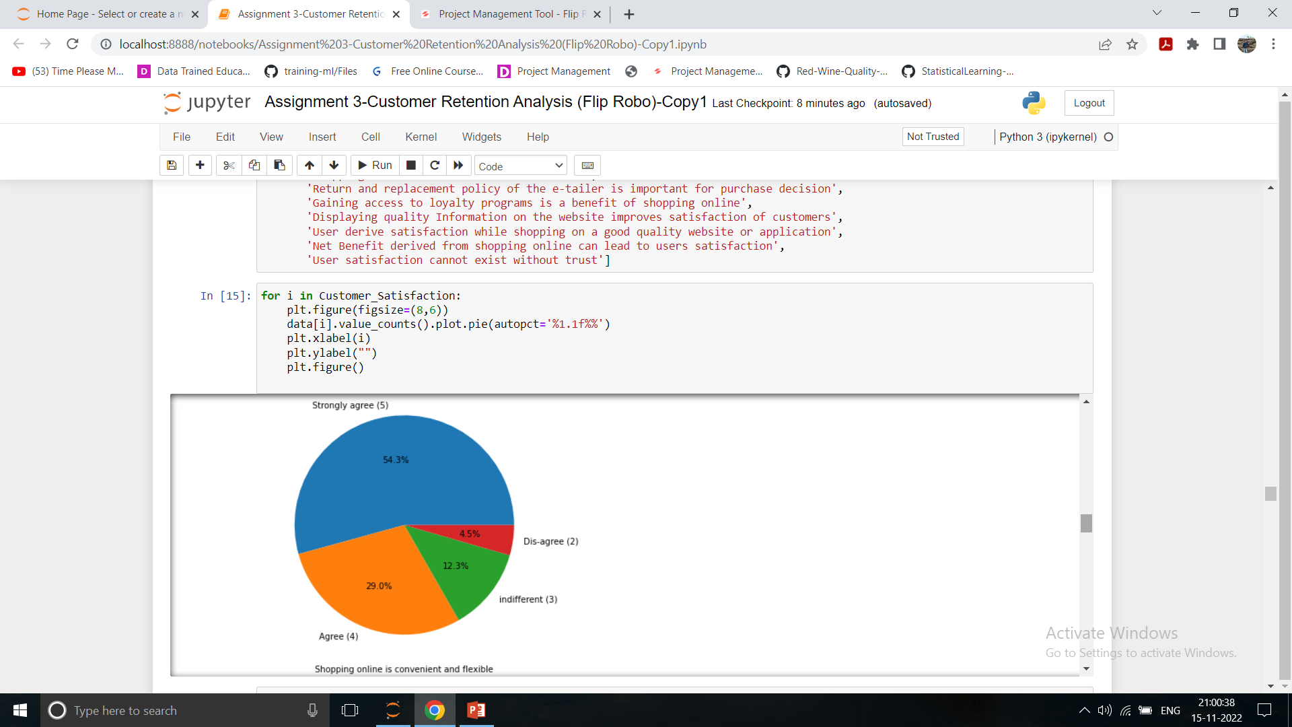
Service Quality

Slide 18
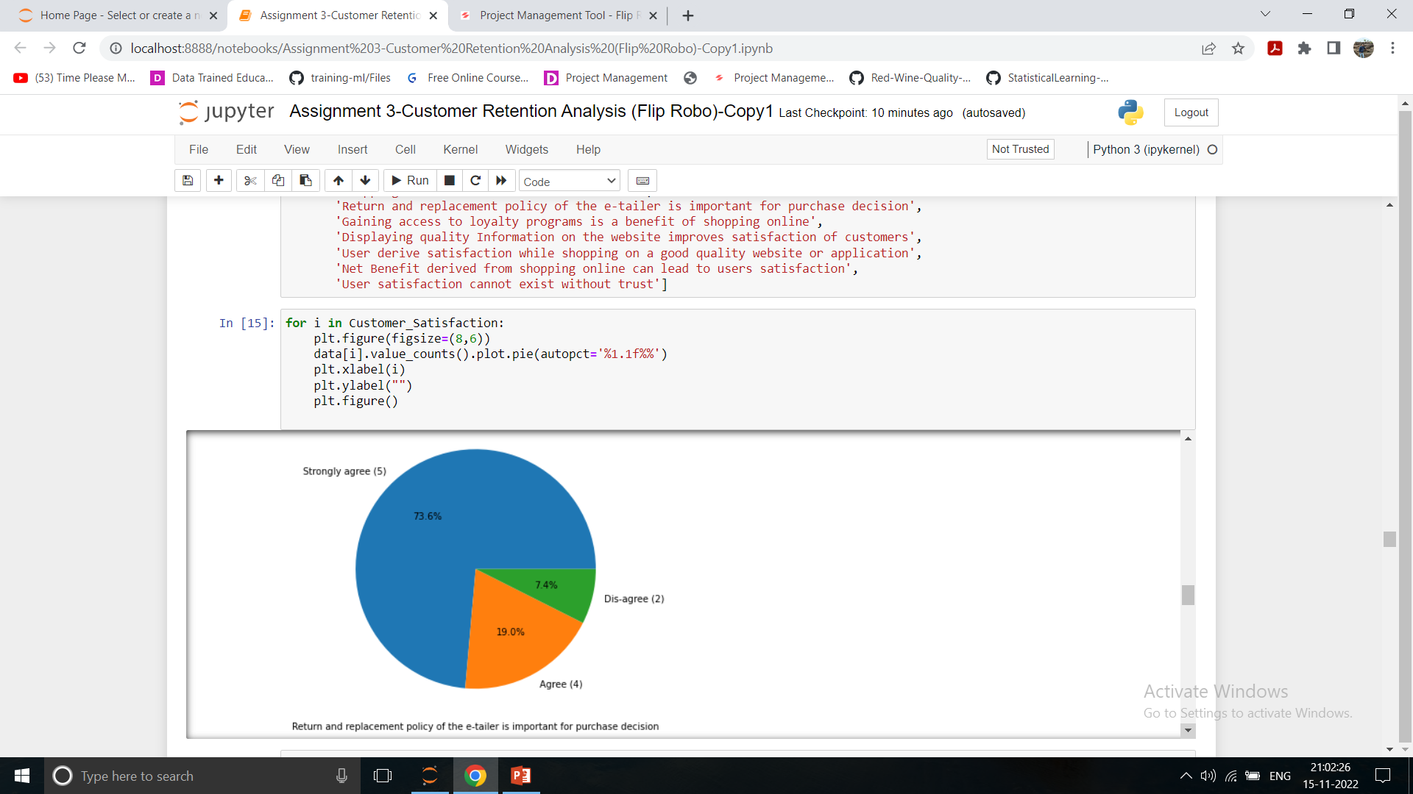
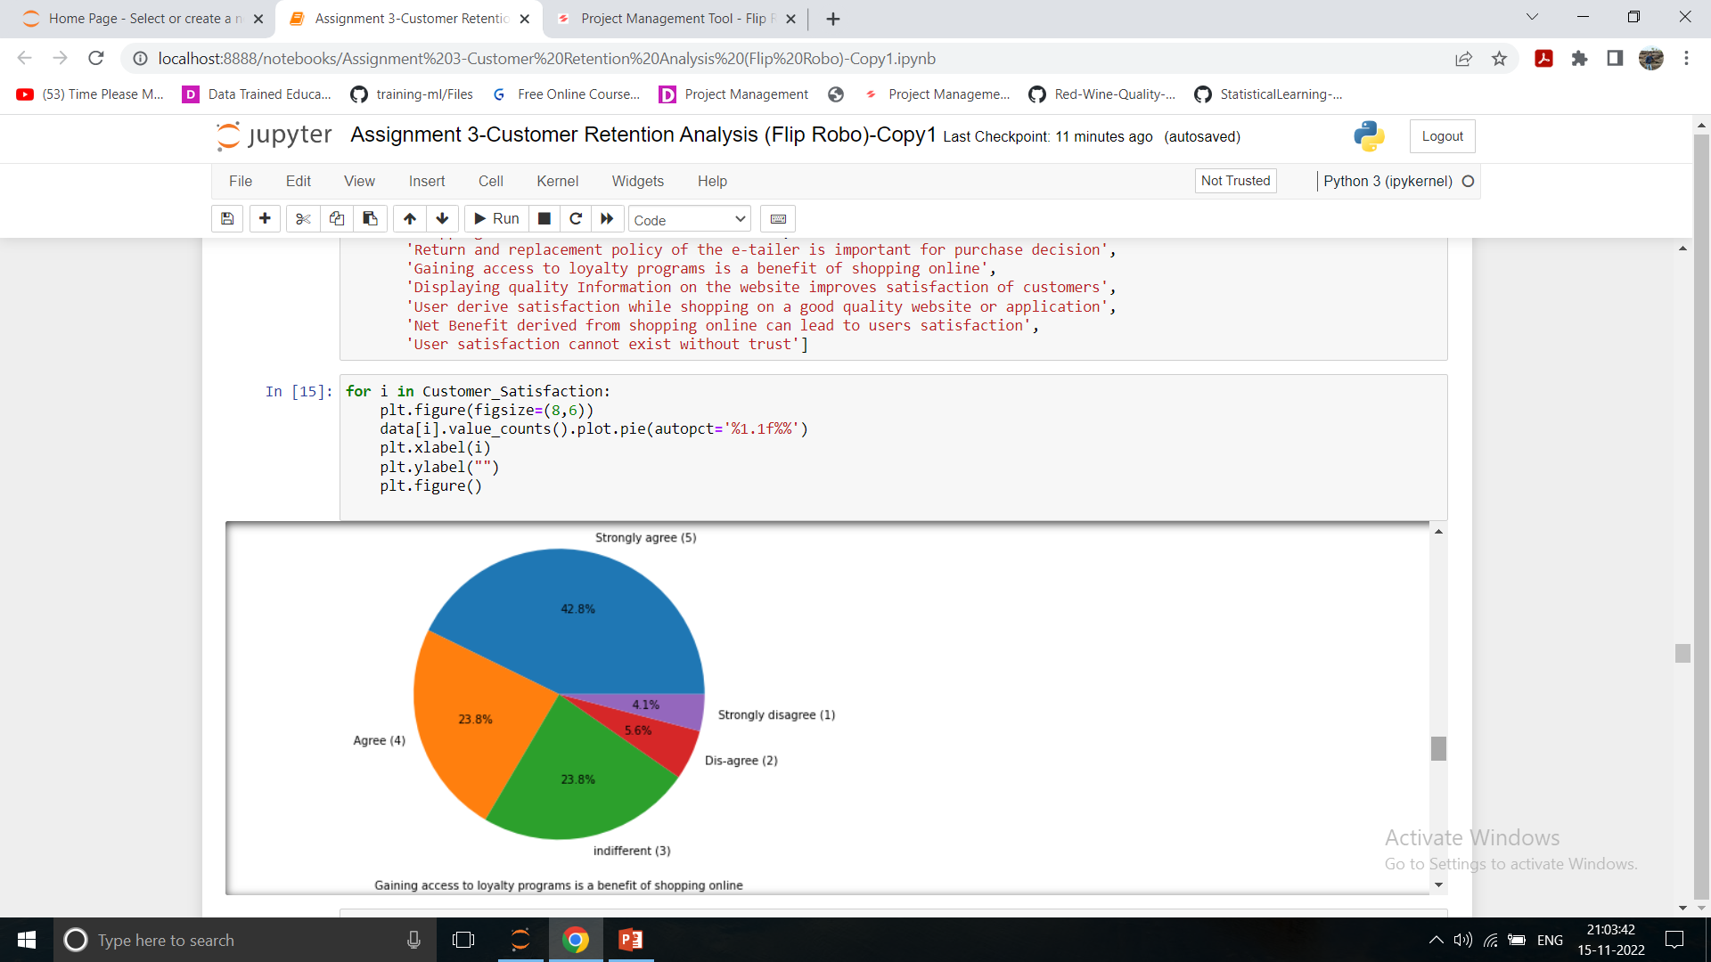
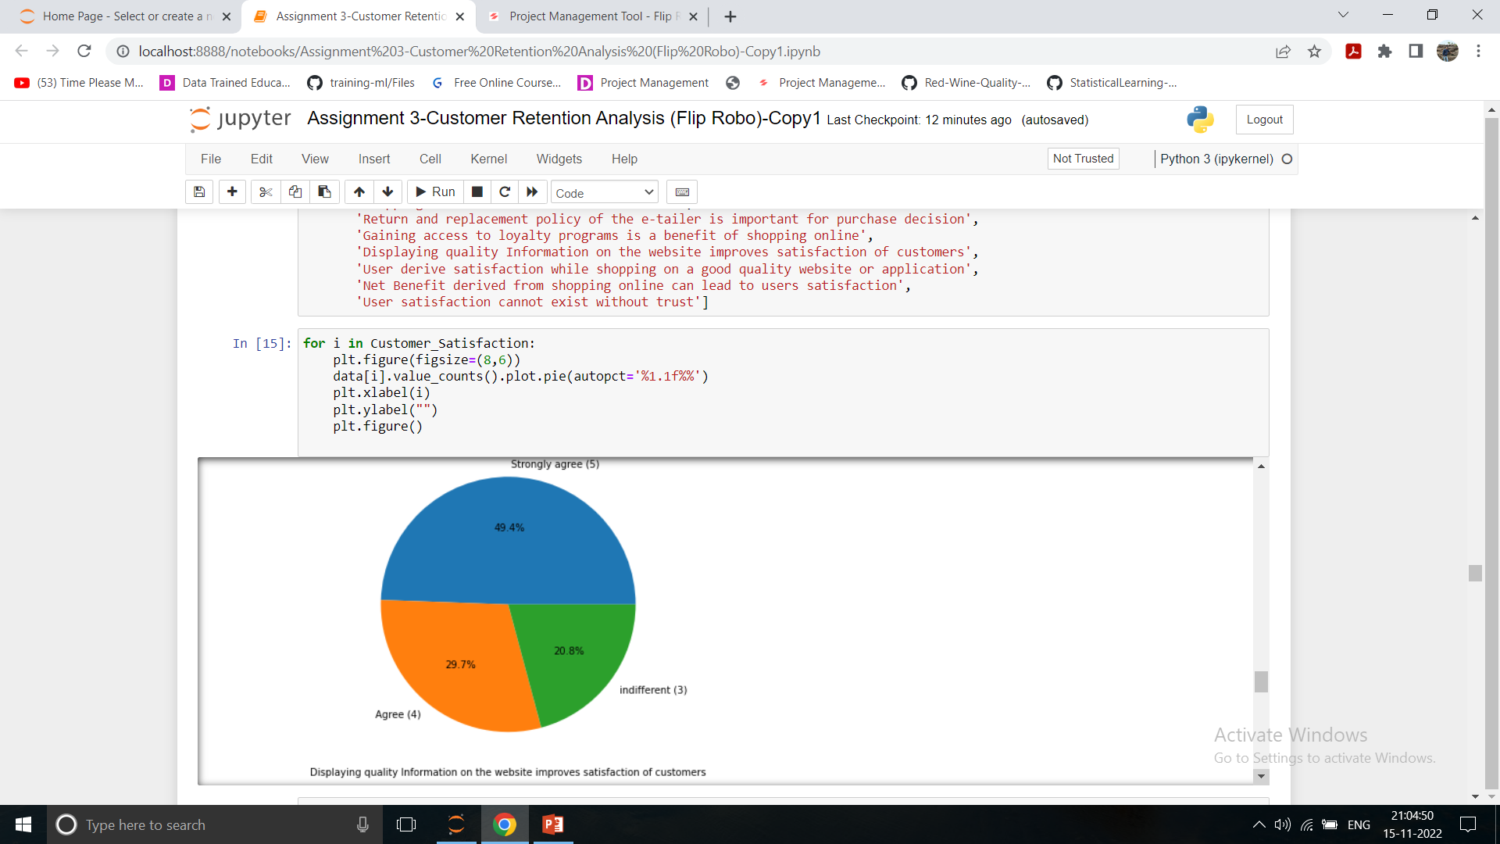
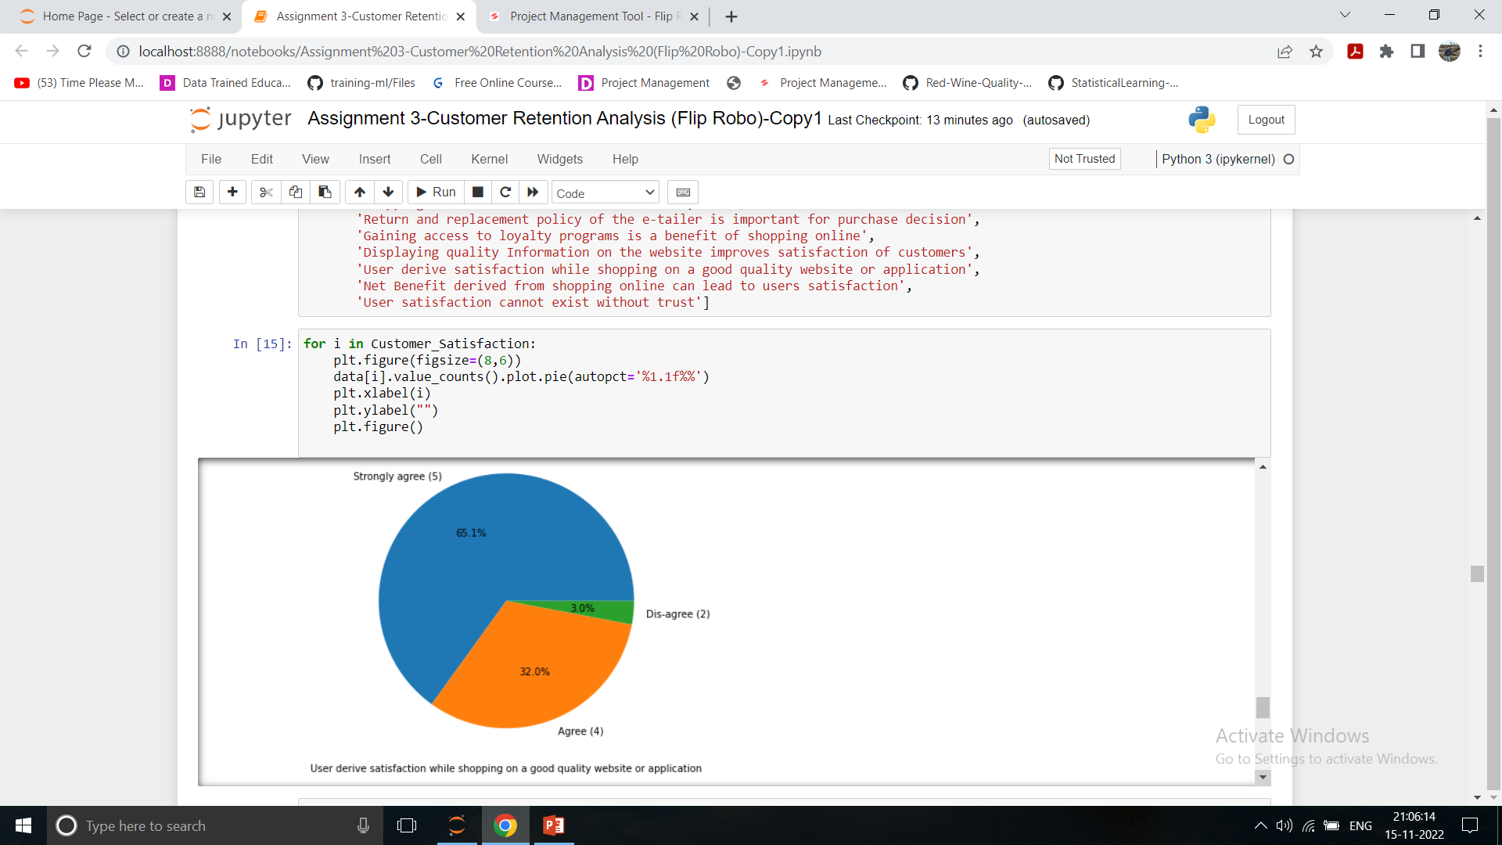
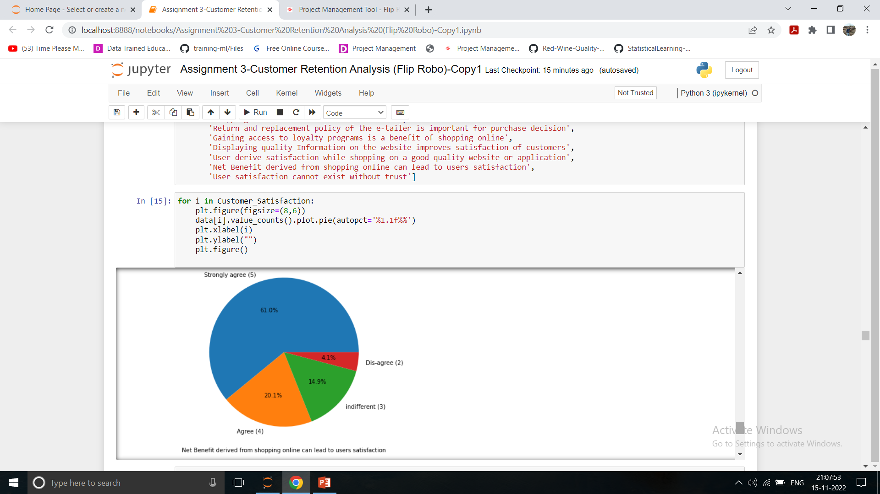
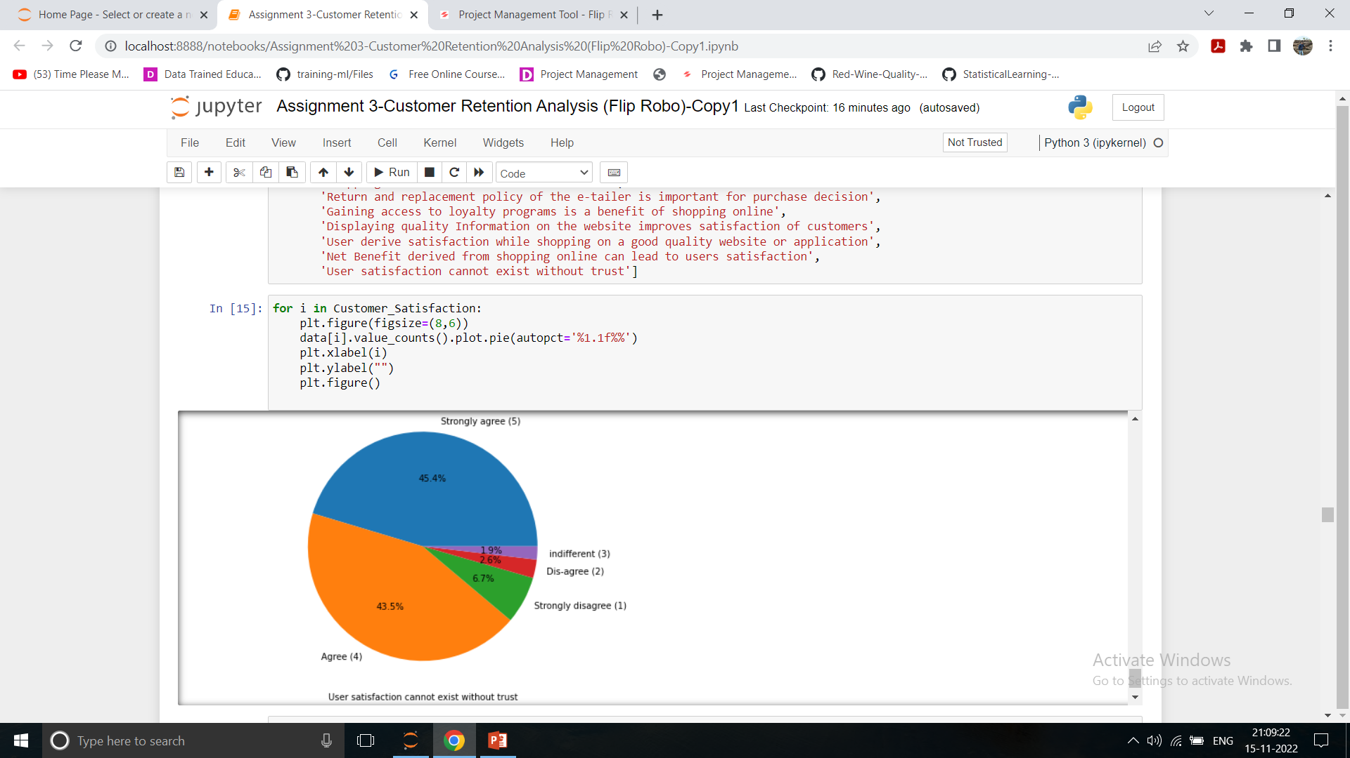
Service Quality

Slide 19
Service Quality Observations
Most of the peoples are strongly agreed & agreed that following points are necessarily required:
Empathy (readiness to assist with queries) towards the customers',
Being able to guarantee the privacy of the customer',
Responsiveness, availability of several communication channels (email, online rep, twitter, phone etc.)',
Online shopping gives monetary benefit and discounts',
Enjoyment is derived from shopping online',
Shopping online is convenient and flexible',
Return and replacement policy of the e-retailer is important for purchase decision',
Gaining access to loyalty programs is a benefit of shopping online',
Displaying quality Information on the website improves satisfaction of customers',
User derive satisfaction while shopping on a good quality website or application',
Net Benefit derived from shopping online can lead to users satisfaction',
User satisfaction cannot exist without trust

Slide 20
Brand Image
Considering all below factors Amazon & Flipcart is having very good brand image as compared to all other E Retail stores:-
online retailers you have shopped from;',
'Easy to use website or application',
'Visual appealing web-page layout', 'Wild variety of product on offer',
'Complete, relevant description information of products',
'Fast loading website speed of website and application',
'Reliability of the website or application',
'Quickness to complete purchase',
'Availability of several payment options', 'Speedy order delivery',
'Privacy of customers’ information',
'Security of customer financial information',
'Perceived Trustworthiness',
'Presence of online assistance through multi-channel',
'Longer time to get logged in (promotion, sales period)',
'Longer time in displaying graphics and photos (promotion, sales period)',
'Late declaration of price (promotion, sales period)',
'Longer page loading time (promotion, sales period)',
'Limited mode of payment on most products (promotion, sales period)',
'Longer delivery period', 'Change in website/Application design',
'Frequent disruption when moving from one page to another',
'Website is as efficient as before'

Slide 21
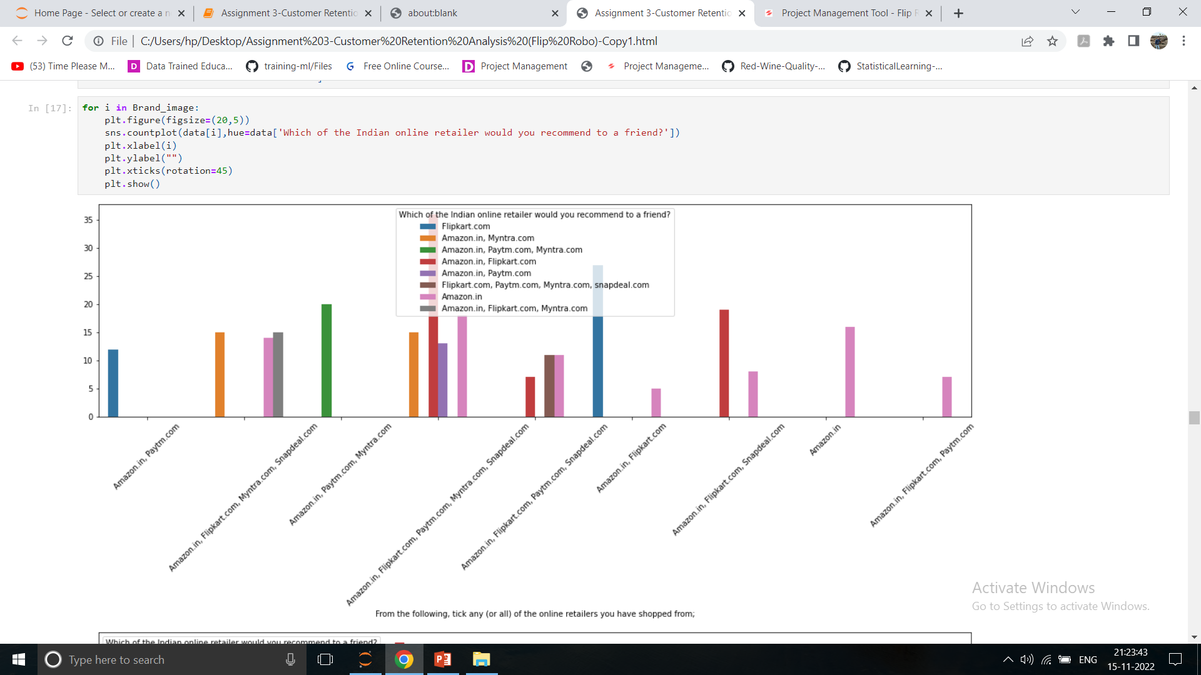
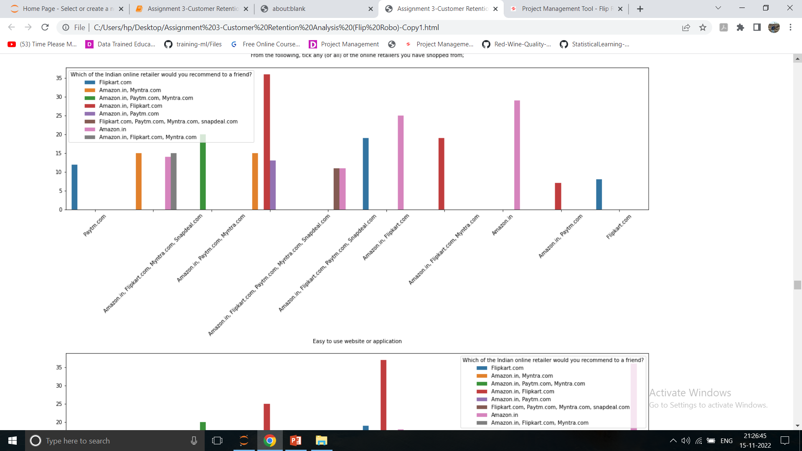
Brand Image

Slide 22
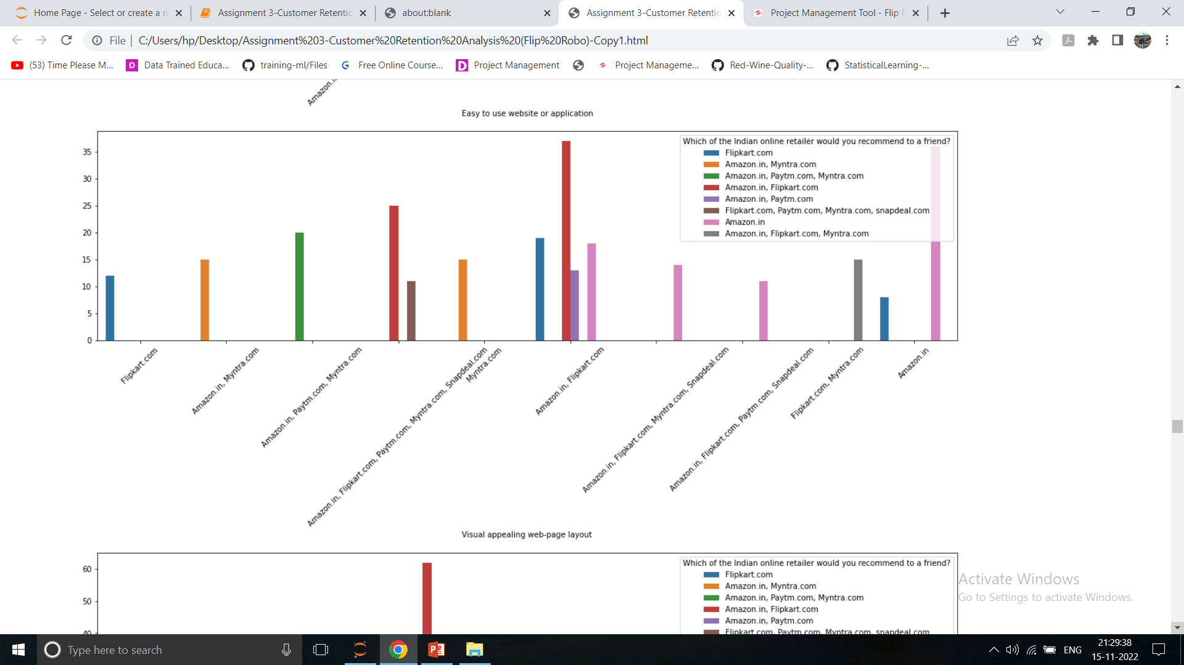
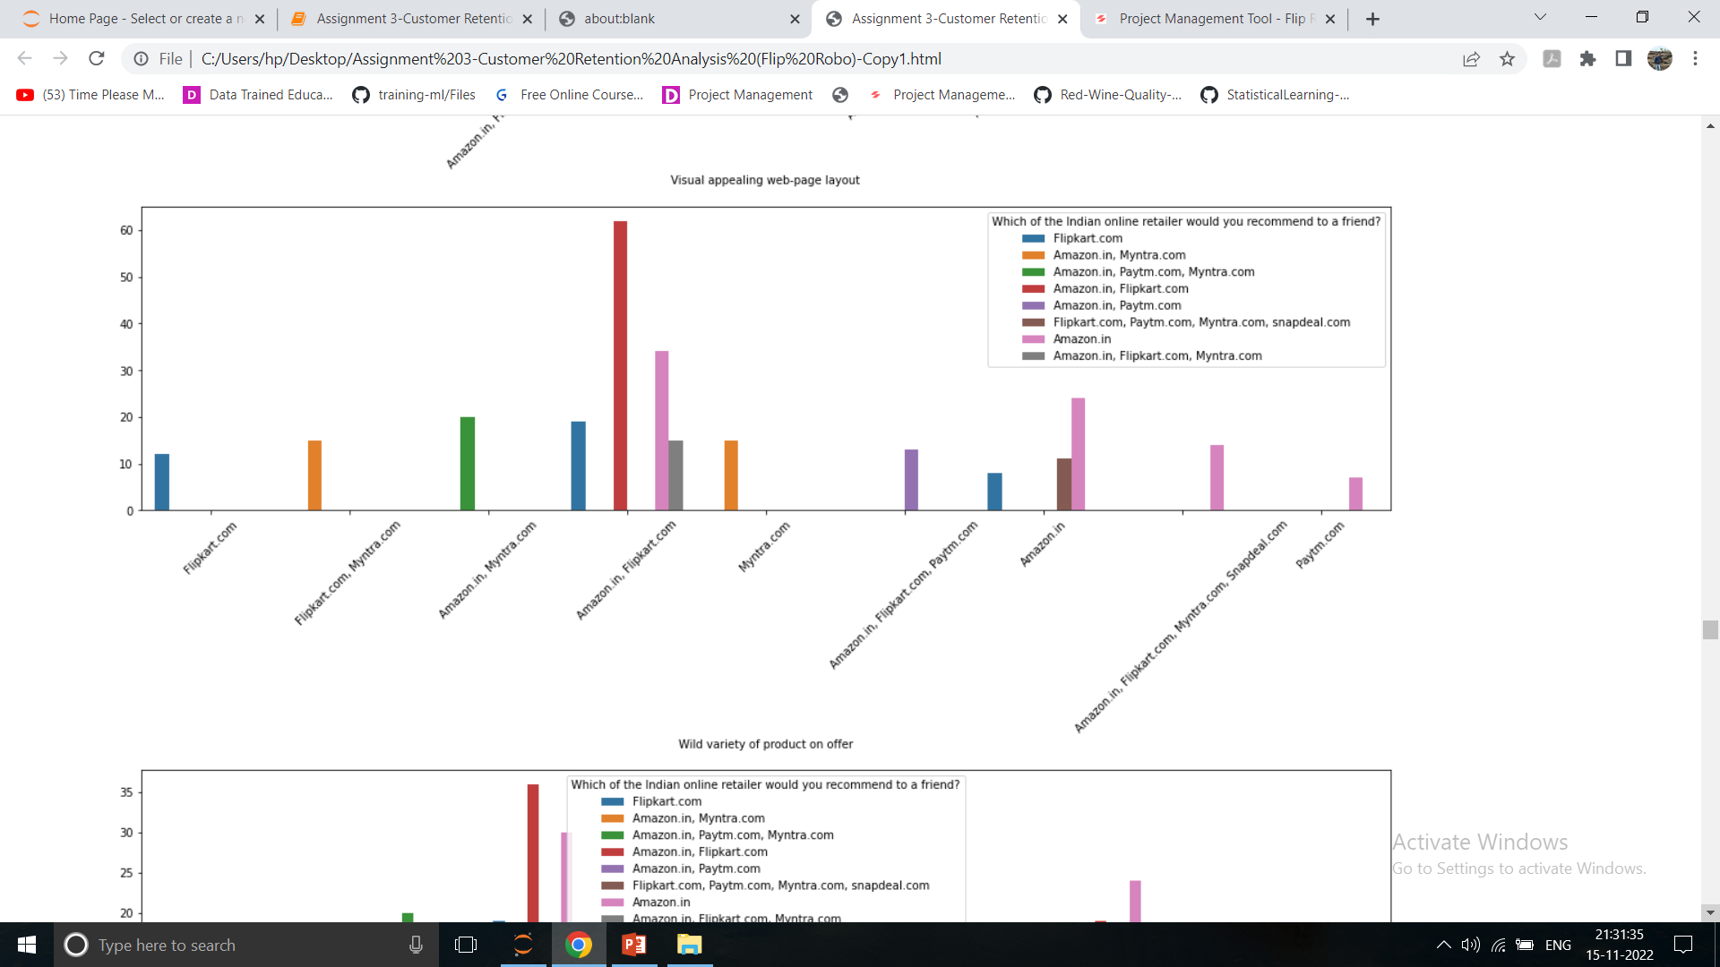
Brand Image

Slide 23
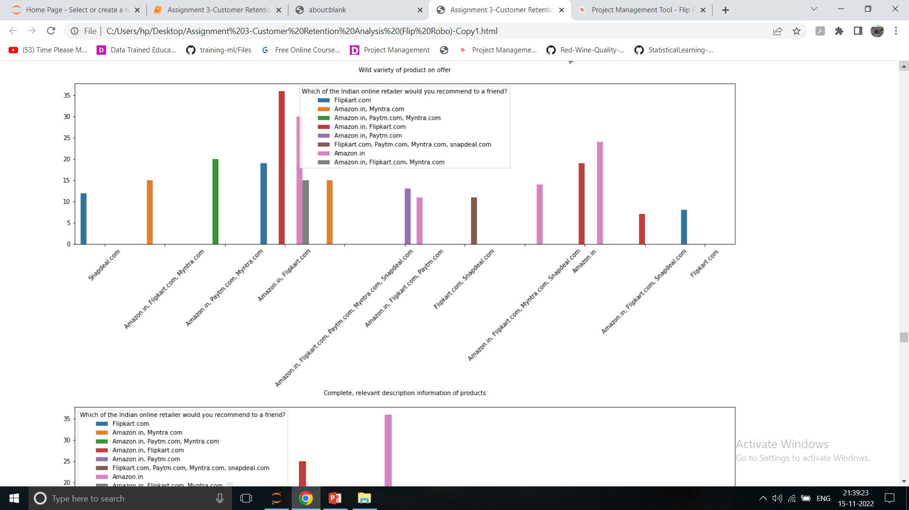
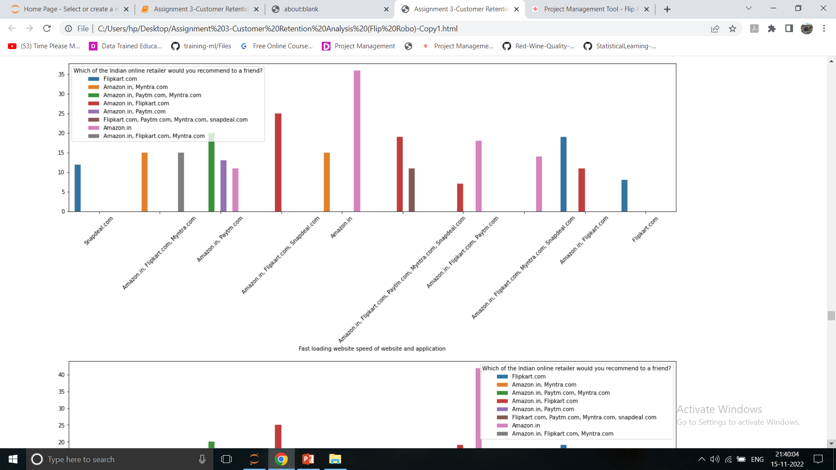
Brand Image

Slide 24
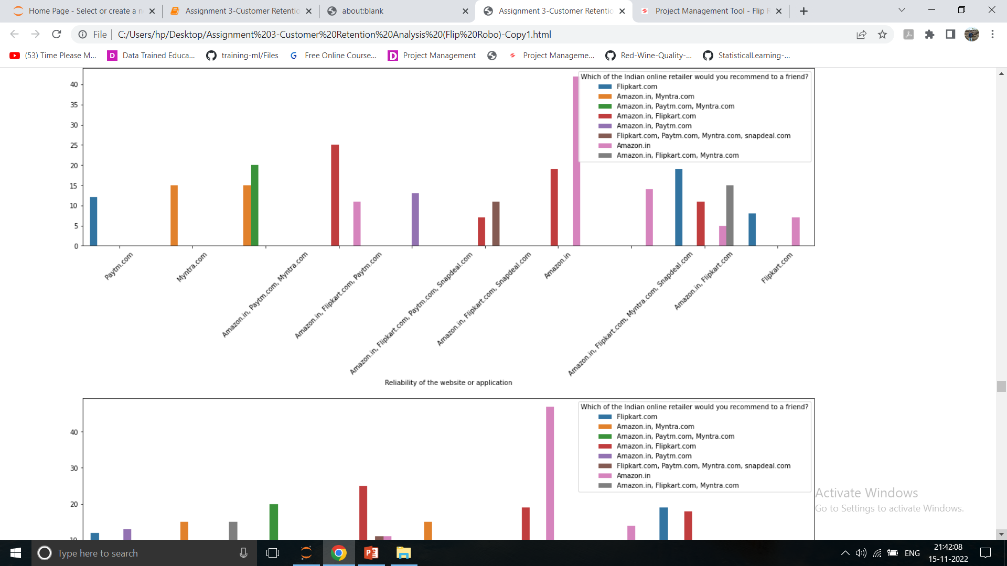
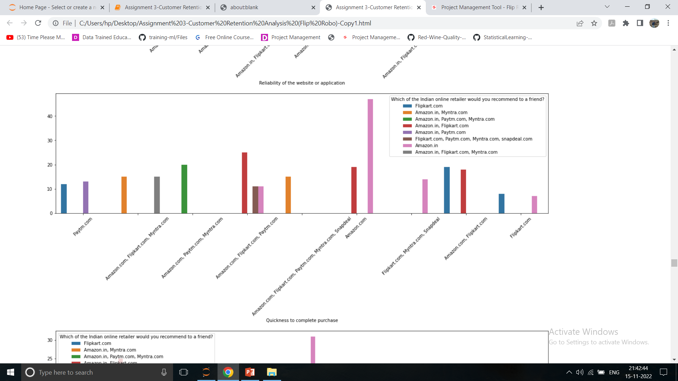
Brand Image

Slide 25
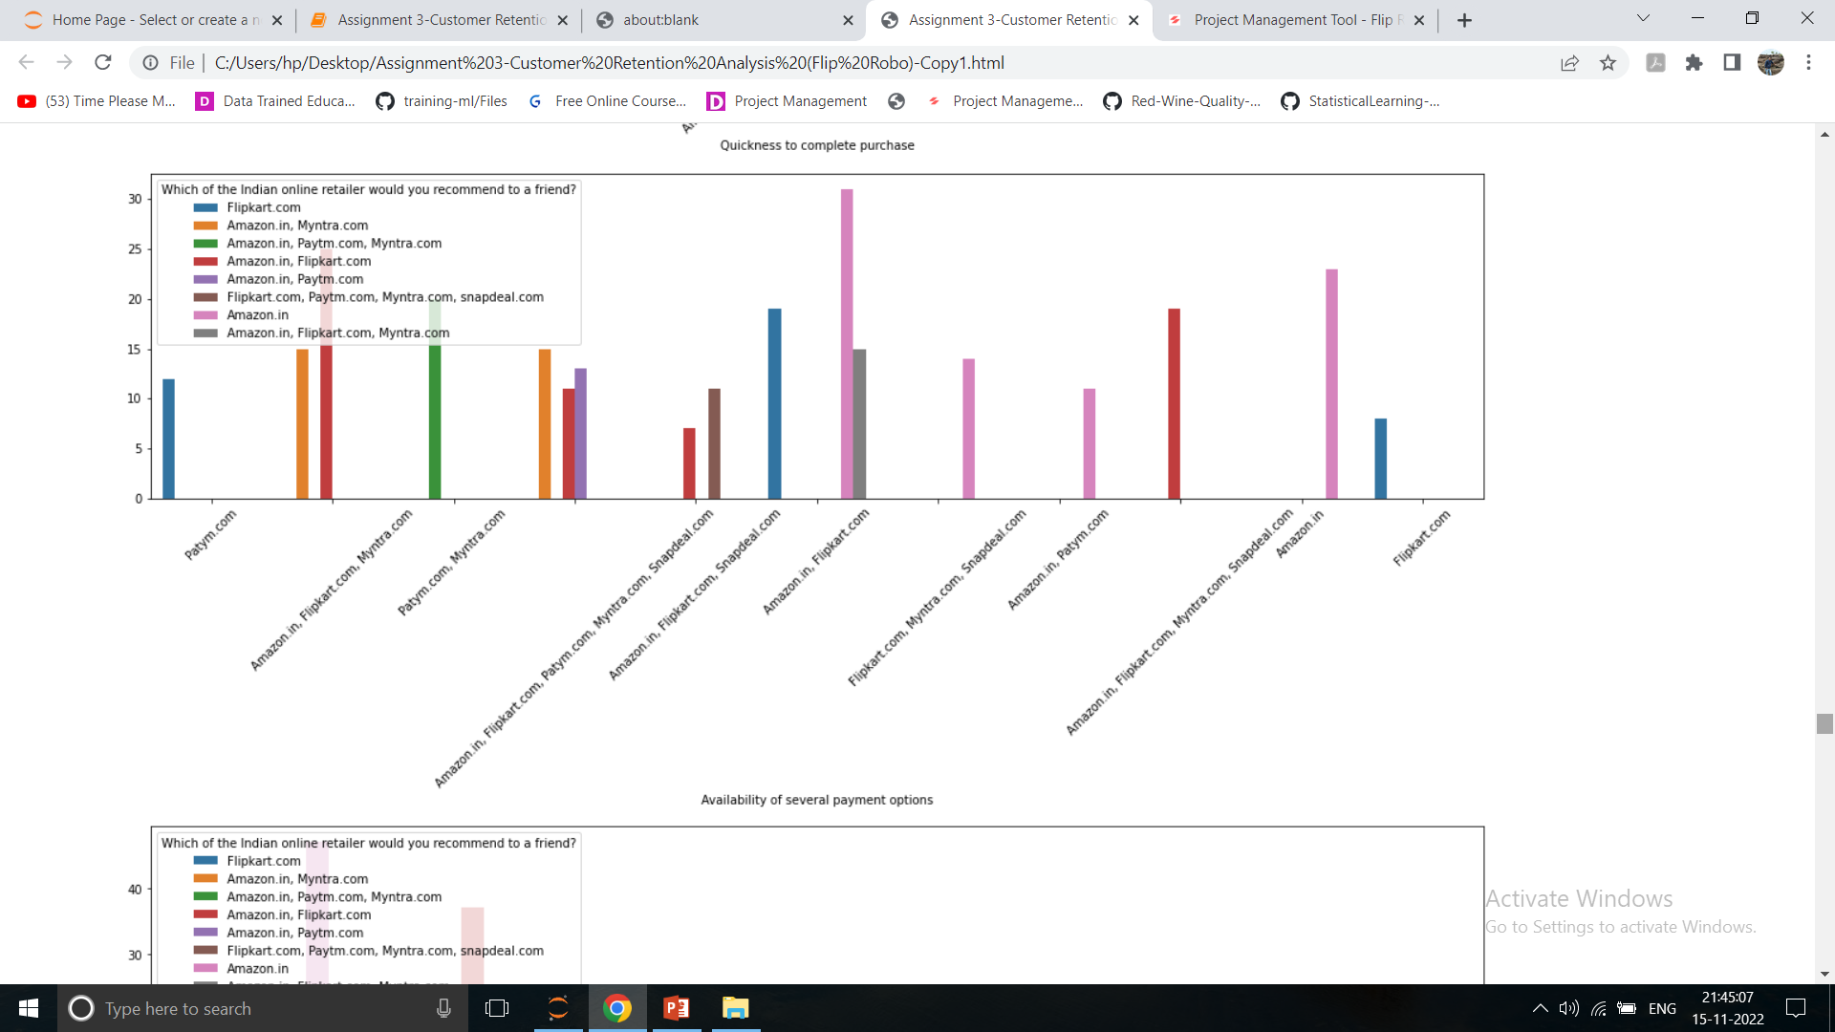
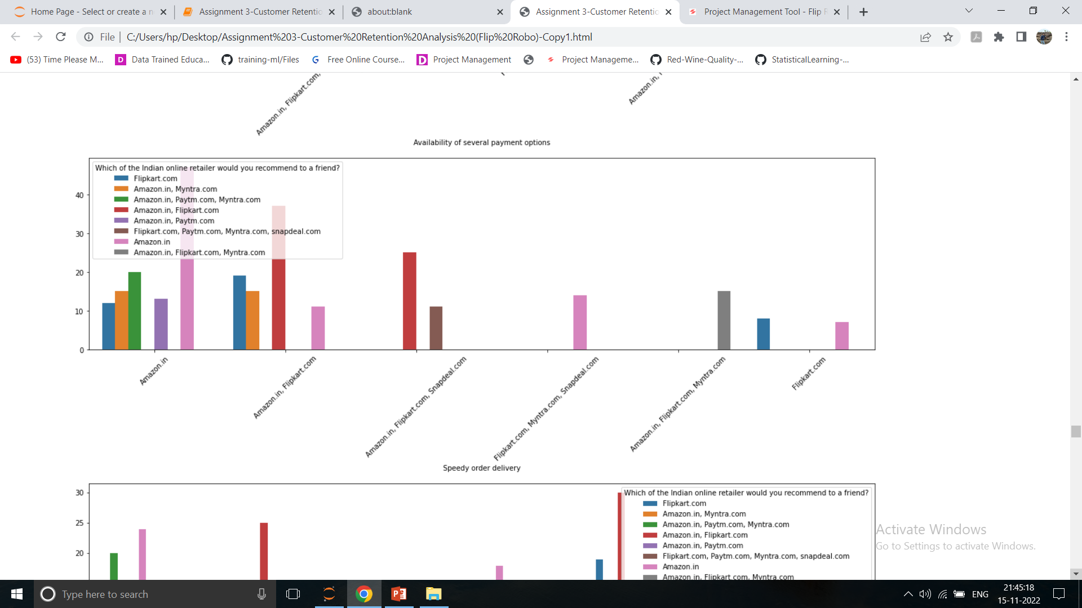
Brand Image

Slide 26
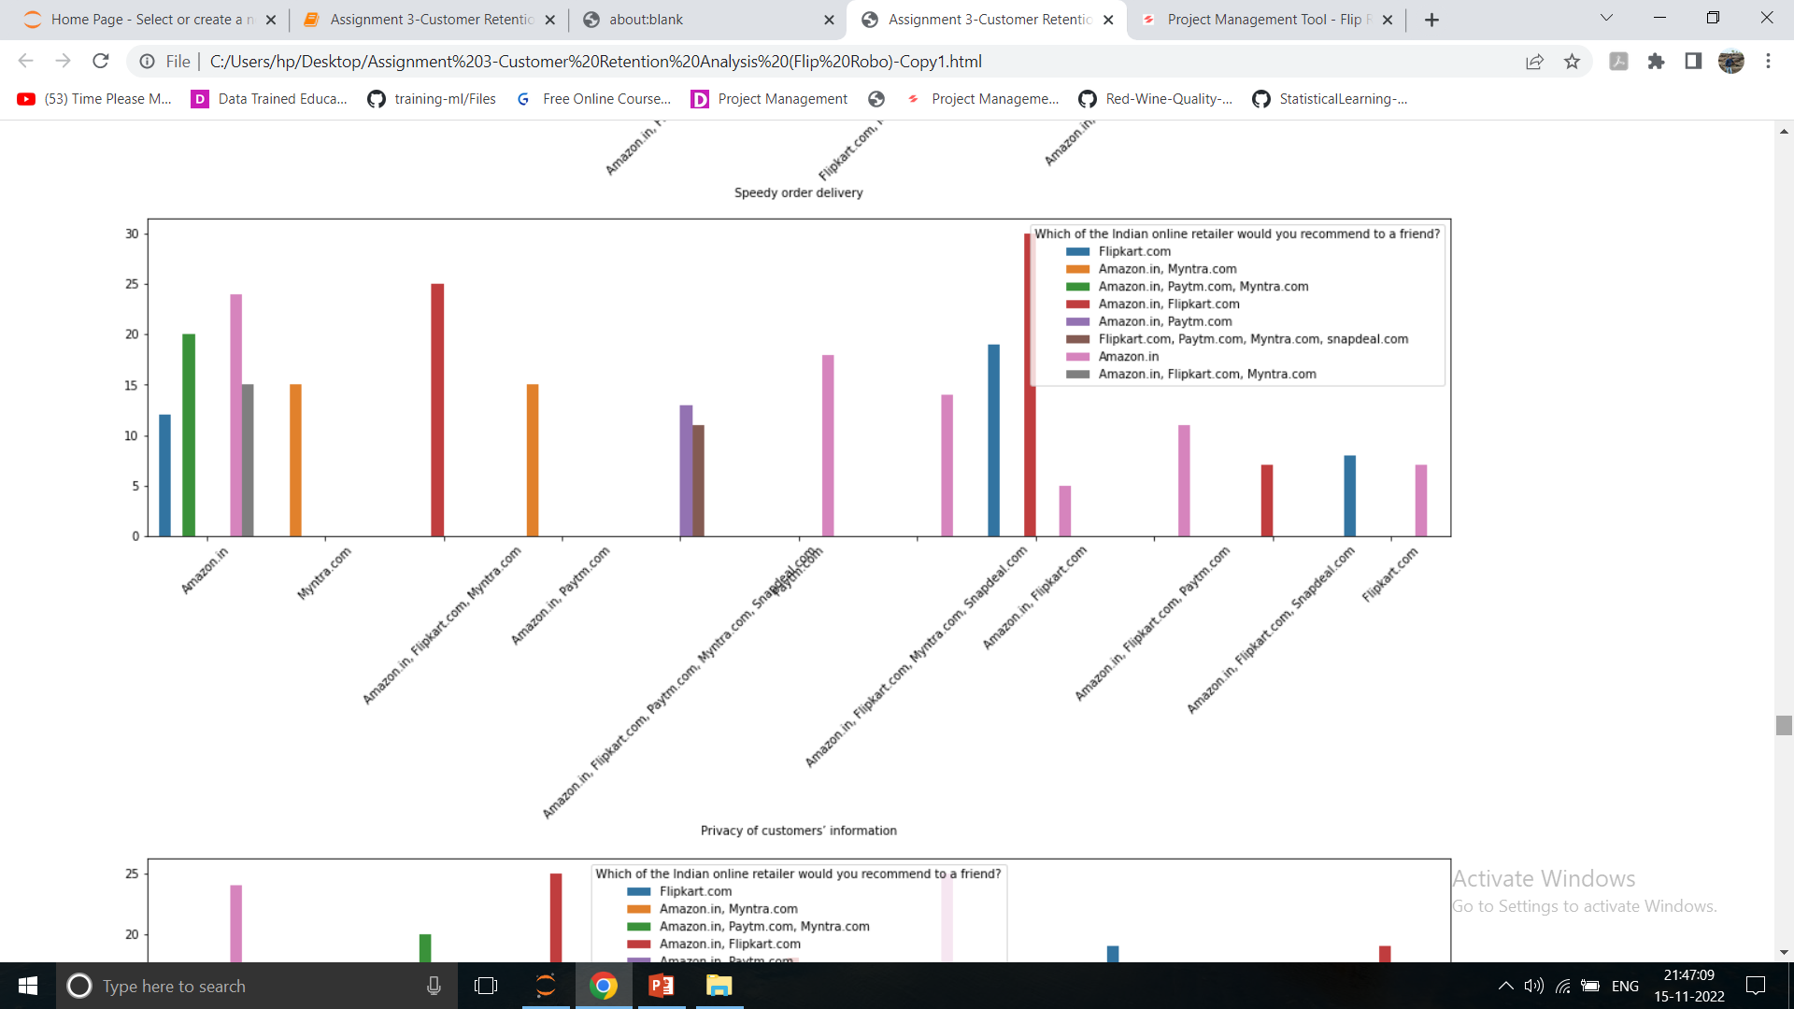
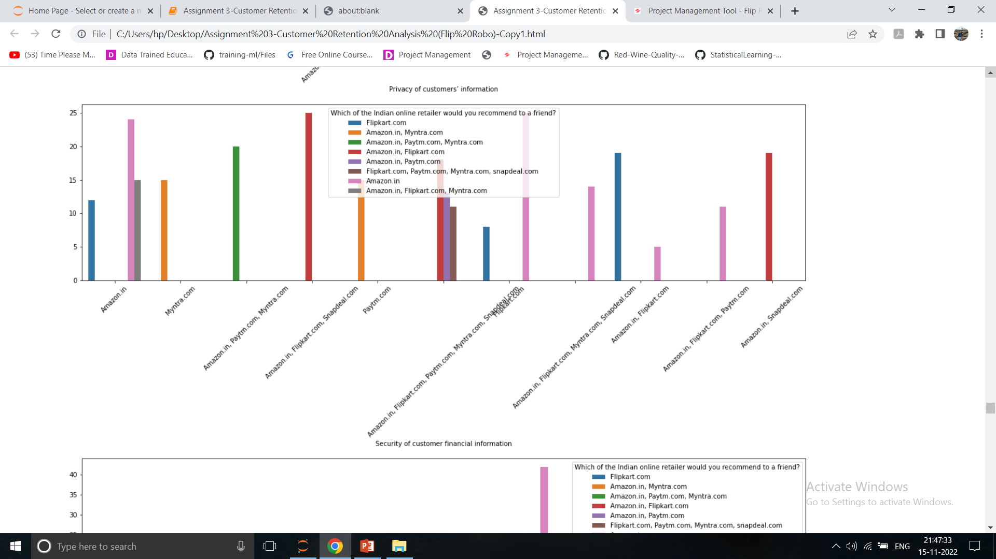
Brand Image

Slide 27


Brand Image

Slide 28


Brand Image

Slide 29


Brand Image

Slide 30


Brand Image

Slide 31


Brand Image

Slide 32


Brand Image

Slide 33
Conclusion
From all above data it is observed that Female E retail customers are higher nos. as compared to male customers.
Delhi is having large no. of customers followed by Greater Noida & Noida, Bangalore.
21-30 Years age group having highest no. of female customers followed by 31-40 years.
Teen ager group less than 20 years & above 51 years in both male & female are having very less no. of customers.
Please are generally using mobile internet to access website from smartphones which is maximum having 5.5 inches screen & using Android Operating system.
Peoples are using search engine Google chrome to reach favourite E retail store first time & 32% peoples are using Application & 32% people using search engine for second time visit.
Sometime around 67% peoples abandon the item in cart due o better alternative offer, Promo code is not applicable & Change in price.
Most of peoples are strongly agreed & agreed in favour that the content on the website must be easy to read & understand, information on similar product to the one highlighted is important for product comparison, complete product is important for purchase decision & all relevant information on listed products must be stated clearly.
Most of peoples are strongly agreed that E retail store must be taking care the privacy of customer details, bet benefit, resolve customer problem, return & replacement quickly, product information & details must be properly mentioned on the web.
Amazon & Flipcart is having very good brand image as compared to other E retail shop considering the verity of products, quick delivery, customer satisfaction, easy return & replacement policy, payment security, customer details privacy 'Complete, relevant description information of products, Fast loading website speed of website and application, Reliability of the website or application, Quickness to complete purchase, Availability of several payment options, Speedy order delivery, Perceived Trustworthiness, Presence of online assistance through multi-channel,

